Slide 1
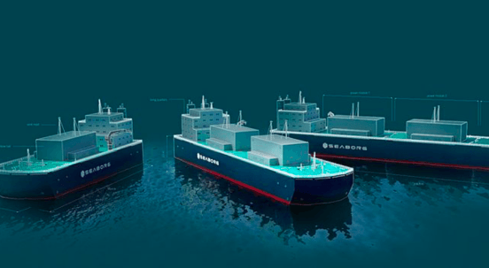
FLOATING NUCLEAR POWER PLANT
Střední průmyslová škola strojní a elektrotechnická České budějovice, dukelská 13

Slide 2
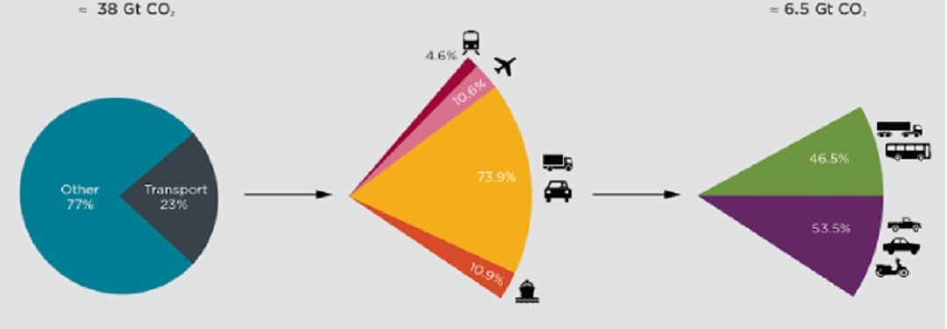
ADVANTAGES OF NUCLEAR POWERED CONTAINER SHIPS
Graph of emissions in transport
Ships are not in themselves the biggest producer of emissions, but thanks to global trade they are an integral part of our lives.
We basically cannot do without ships and our only option is to try to replace them with something more ecological.

Slide 3
Pozitive
A possible future could allow radioactive waste to be used as fuel.
Almost zero pollution of nature.
Opening of a new part of the market that uses nuclear energy (possible progress of nuclear technologies)
Opening of new jobs.

Slide 4
NegativES
Considerable consumption of material and money to build new places where the ships could be assembled + the ships themselves.
The possibility of nuclear accidents that could have fatal consequences.
Operating the ship would become much more difficult.

Slide 6
Thank you for your attention

