Slide 1

OUR REBUILT VW T1 FOR THE FUTURE
MAJER, KUČERA, MYDLIL, ELIŠKA, MÍKA, KLIMEŠ

Slide 2
WHAT WILL IT BE ABOUT ?
At first we will introduce THE NEW FACE OF OUR T1
Then we will talk about MULTI-FUNCTIONAL WHEELS
Then we will show you TRADITIONAL SURF
Next will be FOLDING WINGS
And finally we will tell you something about FUEL TANK

Slide 3
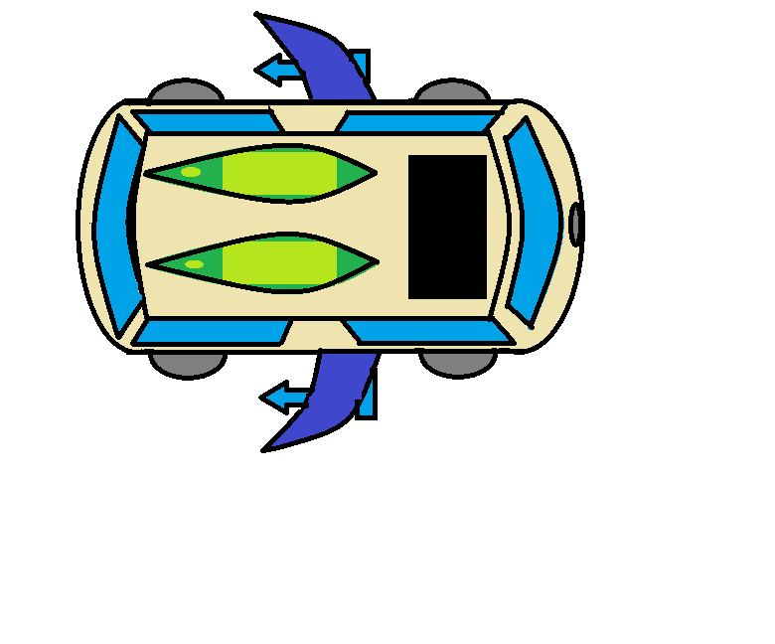
THE NEW FACE OF OUR T1
Everything new except the original face
Evolutionary flying car powered by hydrogen
Considerate of the ecological situation
Ground-breaking new multi-functional components …

Slide 4
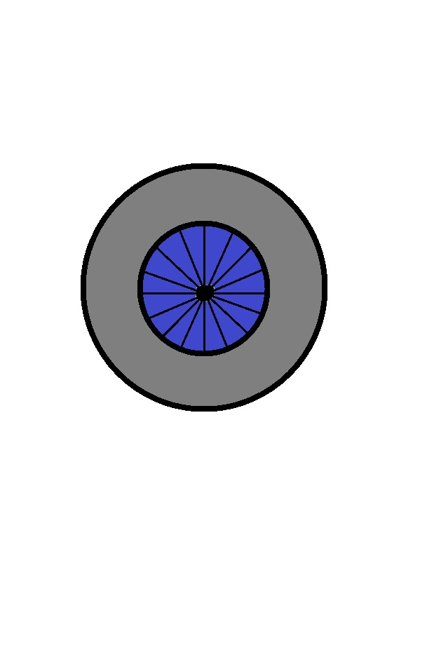
MULTI-FUNCTIONAL WHEELS
They allow the car to drive on the ground or giving the car ability to fly
Made out of lightweight but strong material
Tires are ecologically made out of natural rubber

Slide 5
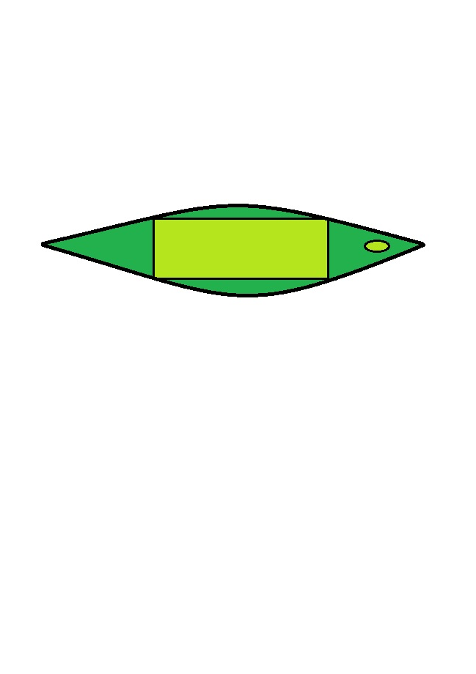
TRADITIONAL SURF
Traditional surf cant be missed for compliance with the original appearance
There is solar panel built into the surf for battery charging

Slide 6
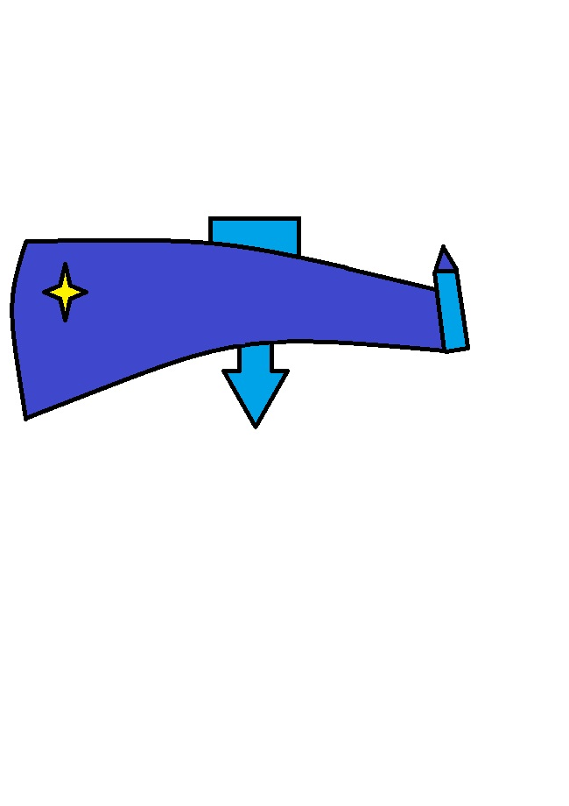
FOLDING WINGS
Made out of carbon fibers
With small powerful turbine for more powerful flying
Wings are folding for practicality in normal operations

Slide 7
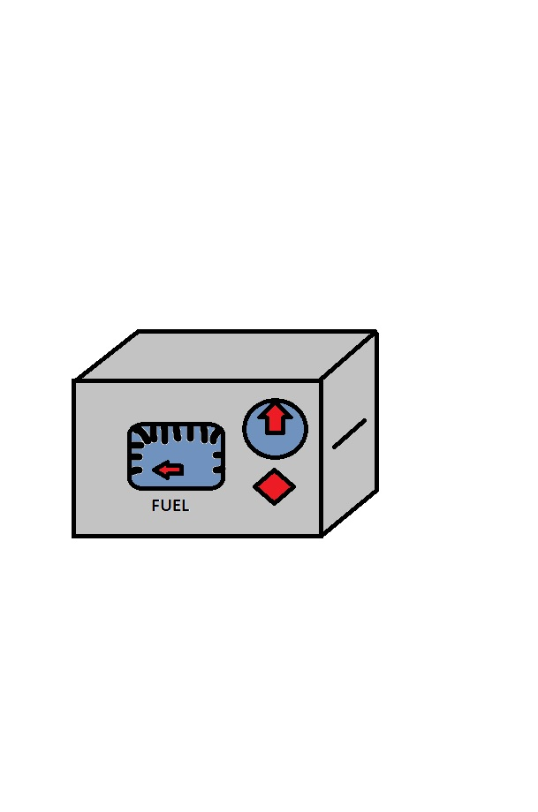
FUEL TANK
Tank is made especially for hydrogen
100% verified security
(made out of strong material + lots of sensors)
With digital display with fuel information (pressure and volume)

Slide 8
THANK YOU FOR YOUR ATTENTION

