Slide 1
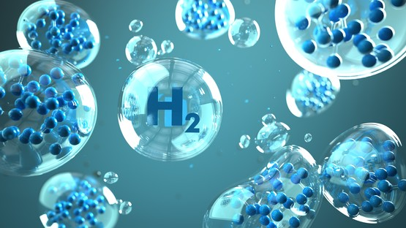

HYDROGEN CAR
By: The Alpha group

Slide 2
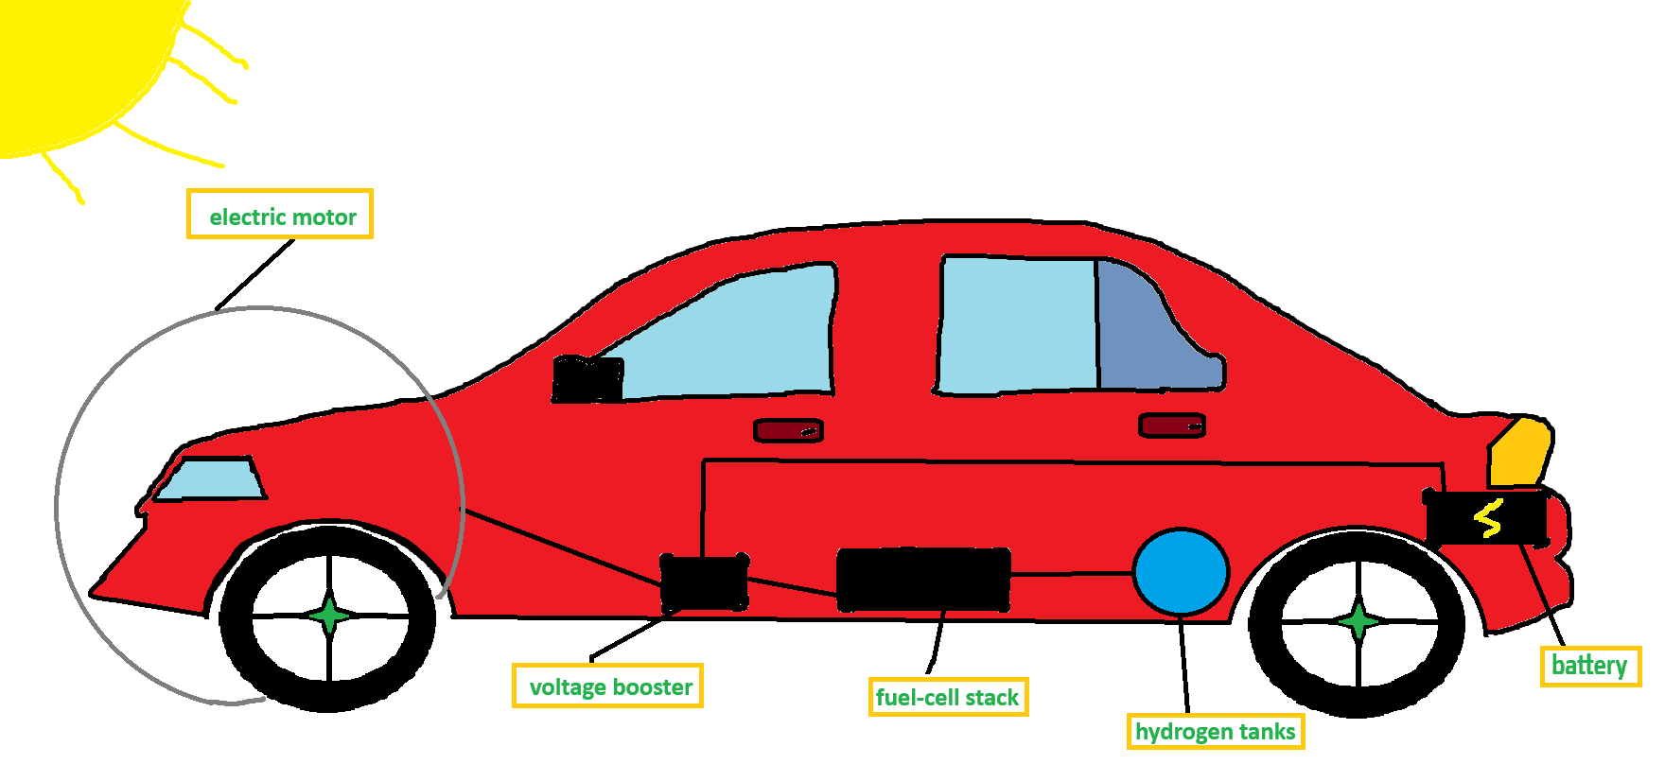
ILLUSTRATION

Slide 3
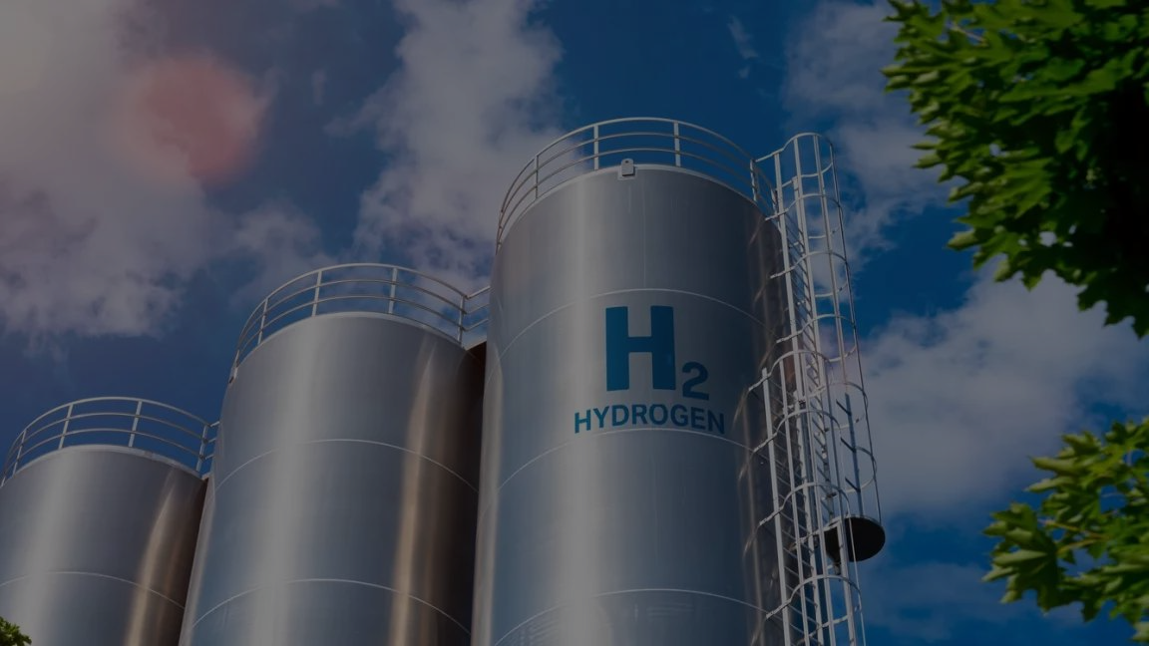
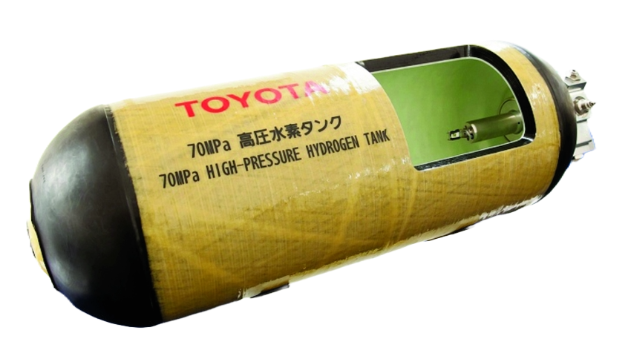
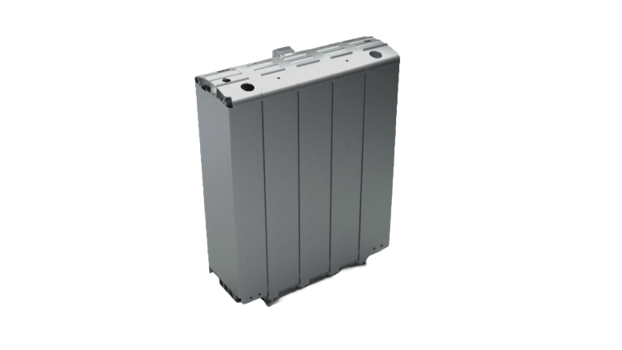
HYDROGEN TANKS
Hydrogen tanks – are used to store hydrogen (fuel) which is compressed. The tanks are made out of layers of carbon fiber to withstand the pressure and prevent rapturing in an accident.
FUEL-CELL STACK
Fuel-cell stack – the hydrogen flows into the fuel-cell stack and makes electricity because of the reaction between hydrogen and oxygen.

Slide 4
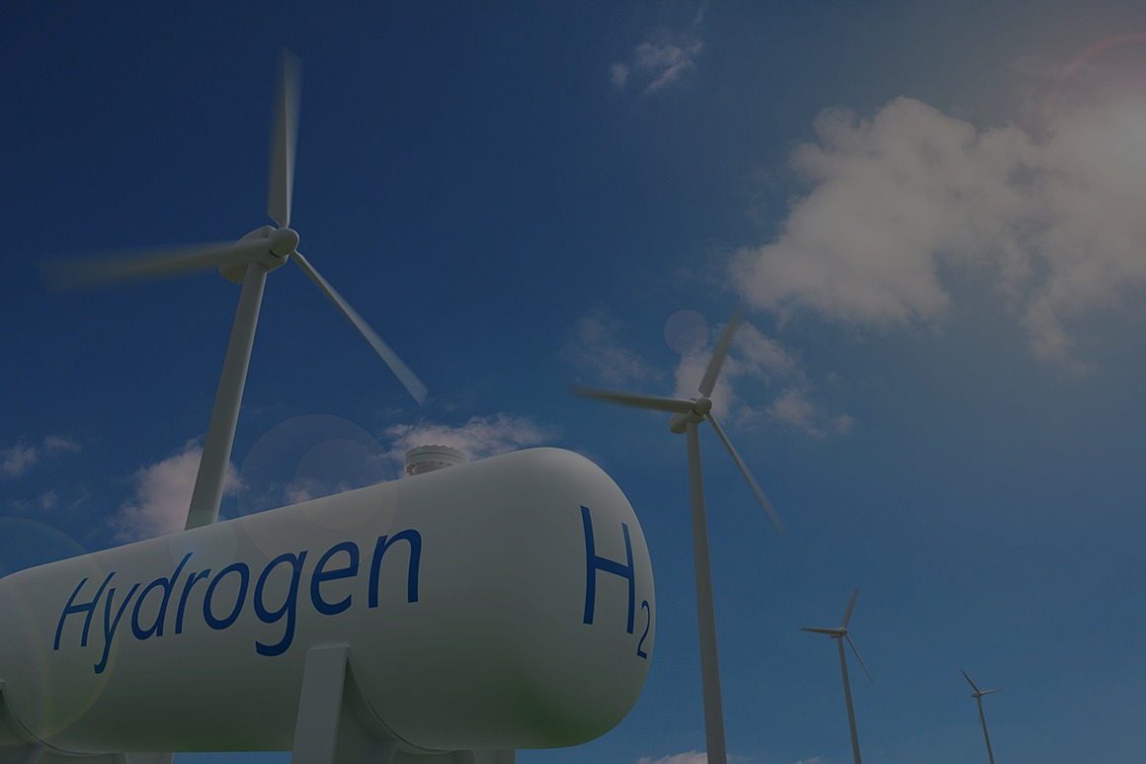
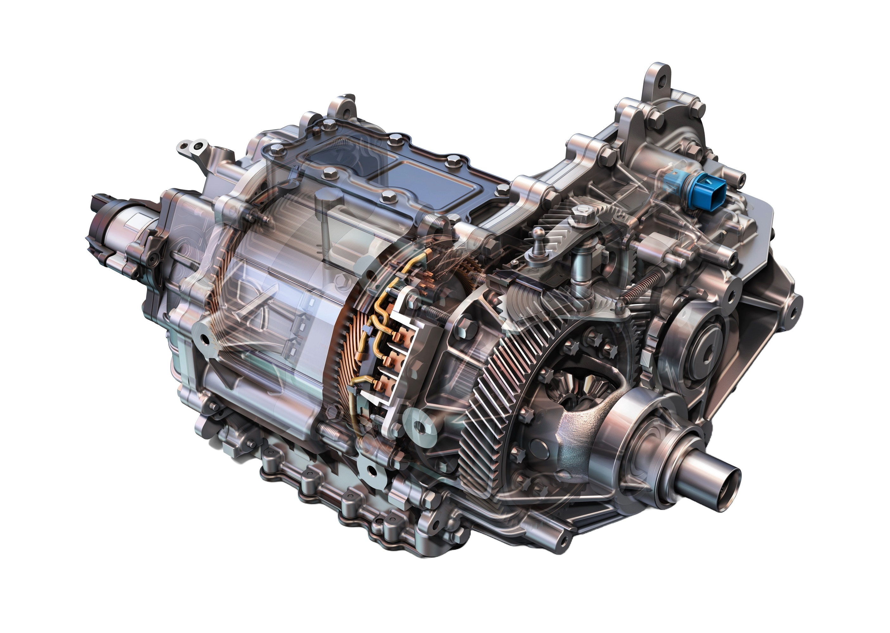
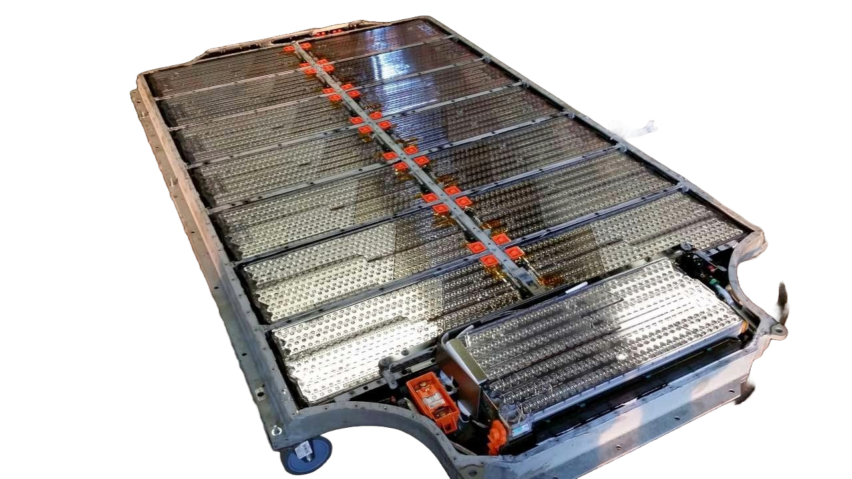

ELECTRIC MOTOR
Electric motor – produces horsepower and torque using the electricity made by the fuel-cell stack
BATTERY
Battery – stores the unused electricity as a backup
VOLTAGE BOOSTER
Voltage booster boosts the power output up to 600V

Slide 5

WHAT THE FUTURE HOLDS
We sincerely hope that this vehicular object and the technology will be used in the future of the human kind because it will decrese carbon emitions and will not consume gasoline.
It may be a little more expensive than a normal car but it is defInitely worth it in the long run.

Slide 6
Sources for pictures :
https://www.google.com/url?sa=i&url=https%3A%2F%2Fbioneers.org%2Fgreen-new-deal-round-table-ztvz2002%2F&psig=AOvVaw3ai4CW7WscdJjf1eeGKcsh&ust=1695390601689000&source=images&cd=vfe&opi=89978449&ved=0CBAQjRxqFwoTCPC7yKzsu4EDFQAAAAAdAAAAABBU
https://www.google.com/url?sa=i&url=https%3A%2F%2Fwww.eenews.net%2Farticles%2Fhydrogen-and-the-epa-power-plant-rule-3-issues-to-watch%2F&psig=AOvVaw248YSNuuV0abgJxY8Tc5Yr&ust=1695385711534000&source=images&cd=vfe&opi=89978449&ved=0CBAQjRxqFwoTCLDT4Ivau4EDFQAAAAAdAAAAABBc
https://www.qnovo.com/blogs/peek-inside-the-battery-of-a-tesla-model-s
https://www.google.com/url?sa=i&url=https%3A%2F%2Fwww.puzzlewood.net%2F%3Fpu%3D5.60.6117677.6.27.88.buy%2Belectric%2Bmotor%2Bfor%2Bcar&psig=AOvVaw04mDyPYsw0BSh8s2gBqzzK&ust=1695392026973000&source=images&cd=vfe&opi=89978449&ved=0CBAQjRxqFwoTCICNoNTxu4EDFQAAAAAdAAAAABAD
https://www.google.com/url?sa=i&url=https%3A%2F%2Fraceenergyperformance.com%2Fproducts%2Fclassic-con-10&psig=AOvVaw3DNk8R8reF7C6T82k-NrXT&ust=1695392149056000&source=images&cd=vfe&opi=89978449&ved=0CBAQjRxqFwoTCJDLqoryu4EDFQAAAAAdAAAAABAD
https://www.researchgate.net/figure/High-pressure-hydrogen-tank-manufactured-by-Toyota16_fig5_328733948
https://www.google.com/url?sa=i&url=https%3A%2F%2Fwww.bosch-mobility.com%2Fen%2Fsolutions%2Fpowertrain%2Ffuel-cell-electric%2Ffuel-cell-stack%2F&psig=AOvVaw0wZ4QMLW9Up-aAbW3LBNU6&ust=1695392236307000&source=images&cd=vfe&opi=89978449&ved=0CBAQjRxqFwoTCPC2xrfyu4EDFQAAAAAdAAAAABAE
https://www.google.com/url?sa=i&url=https%3A%2F%2Fwww.nrdc.org%2Fbio%2Frachel-fakhry%2Fhydrogen-hubs-are-face-americas-hydrogen-rollout&psig=AOvVaw1lKuKhIgTGkgMdREAwInVc&ust=1695392543043000&source=images&cd=vfe&opi=89978449&ved=0CBAQjRxqFwoTCMCO9sbzu4EDFQAAAAAdAAAAABAG
https://www.google.com/url?sa=i&url=https%3A%2F%2Fwww.nationalgrid.com%2Fstories%2Fenergy-explained%2Fwhat-is-hydrogen&psig=AOvVaw1lKuKhIgTGkgMdREAwInVc&ust=1695392543043000&source=images&cd=vfe&opi=89978449&ved=0CBAQjRxqFwoTCMCO9sbzu4EDFQAAAAAdAAAAABAL

