Slide 1
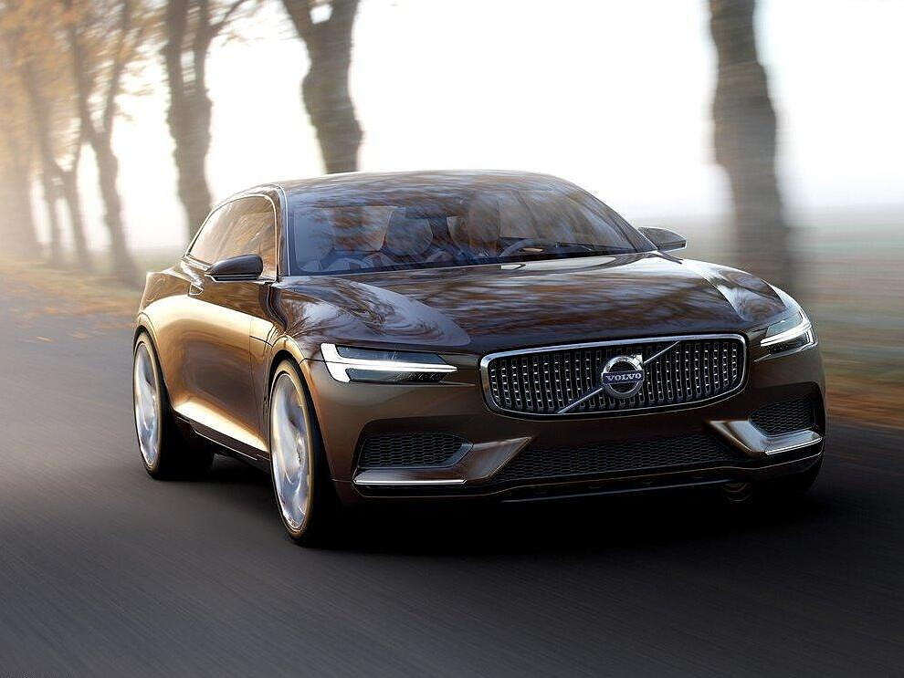


Project Volvo xc Coupe
Rīga 2023
Edgars Lazdins, AV1-1
DanielsTolens, AV1-1
Erics Olavs, DP2-3

Slide 2
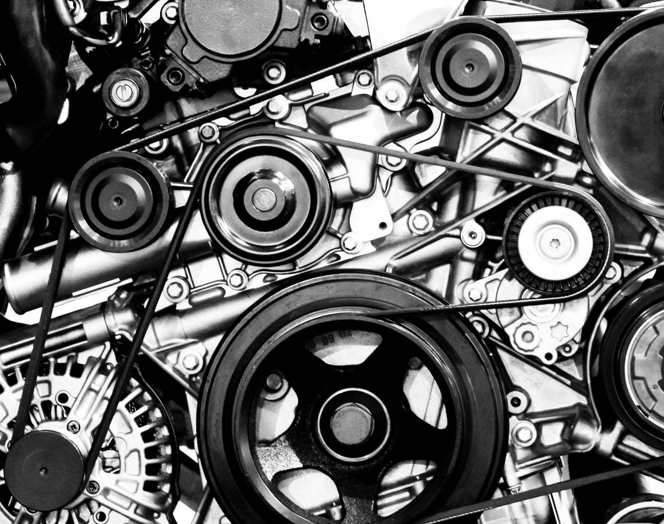
The Volvo XC Coupe
has a 4-cylinder engine that runs on e-fuel and is also electric, which has solar batteries on the roof that charge the battery.
It has 4 seats and the saloon is made from carbon fiber.

Slide 3
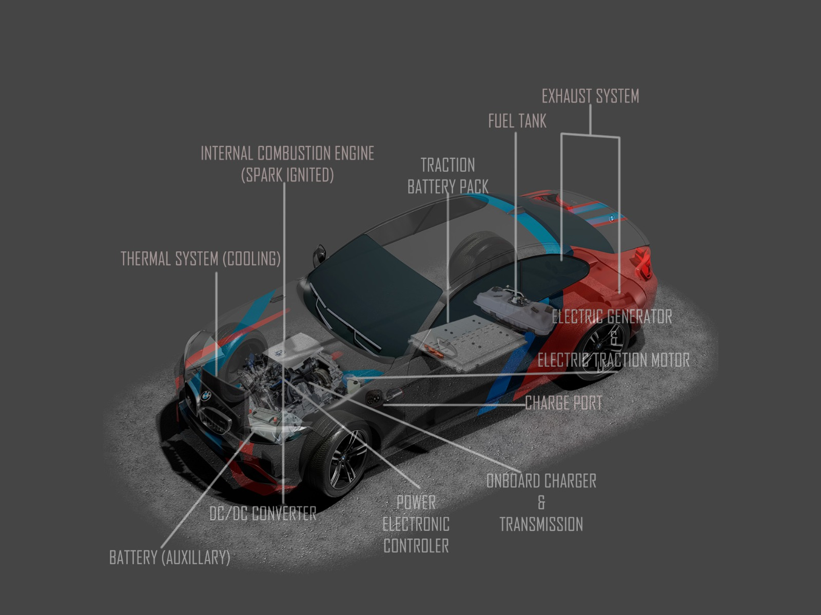

Slide 4
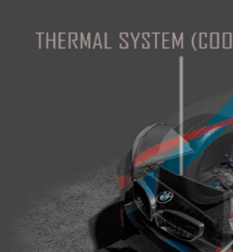
Thermal Cooling System
A car's thermal cooling system is a system that removes heat from the engine, electric motor and electric battery using coolant that circulates through the engine, electric motor and electric battery and radiator.

Slide 5
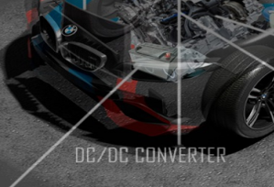
DC/DC Converter
In a car, a DC/DC converter is used to convert the car's battery voltage (12V) to another voltage needed by the car's systems. For example, a car's electric window motor runs on 12V, while a car's audio system runs on 12V or 24V.

Slide 6
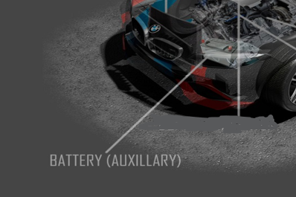
Battery Auxillary
Car's battery backup system is a device that provides additional power to the car's systems when they are not connected to an external power supply. Here are some examples of how battery assist systems can be used in cars: To power GPS and mobile phone while traveling. To power the car's audio system when the car is off. To power appliances such as a refrigerator or air conditioner while camping. To help preserve the car battery when the car is rarely used. An auxiliary car battery is an additional battery that is installed in a car to increase the capacity of the main battery. It can be used for various purposes.

Slide 7
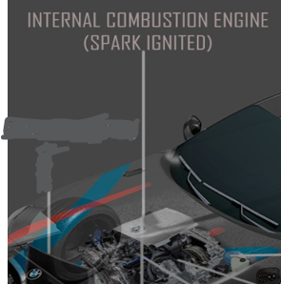
Internal Combustion Engine (Spark Ignited)
A spark ignition engine is an engine in which fuel and air are ignited by a spark. It operates in four strokes: intake, compression, stroke and exhaust.

Slide 8
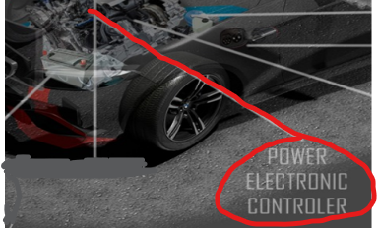
Power Electronic Controler
A power electronic regulator is an electronic device that controls the flow of power through an electrical system. It is often used to control motors, generators and other power elements.In cars: to control engine ignition, fuel supply and other systems.

Slide 9
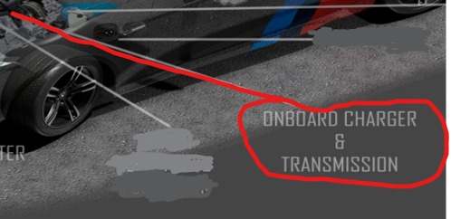
Onboard Charger and Transmission
On-Board Charger: A device that uses current generated by the engine's alternator to charge the battery.
Gearbox: A device that ensures that engine torque is transmitted to the wheels.

Slide 10

Charge Port
A car charging port is a device that allows the car to be charged from the mains. It is an essential element in electric cars and hybrid cars because it ensures that the car battery can be charged to keep the car running properly.

Slide 11
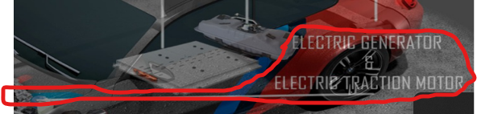
Electric Traction
Motor
Electric Traction Motor: A device that converts electrical energy into mechanical energy.
Some types of electric traction motors.
Advantages of electric traction motors:
More efficient than internal combustion engines
More reliable than internal combustion engines
Produces less pollution
Disadvantages of electric traction motors:
More expensive than internal combustion engines
Heavier than internal combustion engines
A larger battery is required to provide sufficient power

Slide 12
Electric Generator
A car's electric generator is a device that converts mechanical energy into electrical energy. It is an essential element in cars as it ensures that the car batteries are charged to keep the car running properly.
Electric generators are divided into two main categories:
Asynchronous Generators: These generators are simpler and cheaper than synchronous generators. However, they are less efficient and make more noise.
Synchronous Generators: These generators are more efficient and produce less noise than asynchronous generators. However, they are also more complex and expensive.

Slide 13
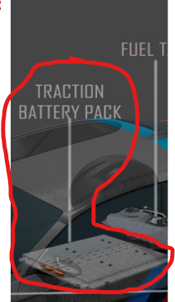
Traction battery pack
A car's traction battery pack is a device that stores the energy used to power the car's electric traction motor. It is an essential element in electric cars because it ensures that the car can move.
The prices of traction battery packs depend on its capacity and manufacturer.

Slide 14
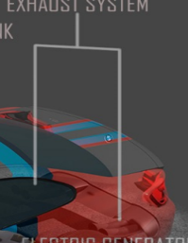
Exhaust System
The exhaust system is a system of pipes and other components that removes exhaust gases from an internal combustion engine. It is an important part of the engine because it helps to reduce emissions and noise.
The exhaust system typically consists of the following components:
Manifold: The manifold collects exhaust gases from the engine cylinders and directs them into the exhaust pipe.
Catalytic converter: The catalytic converter converts harmful pollutants in the exhaust gases into less harmful gases.

Slide 15
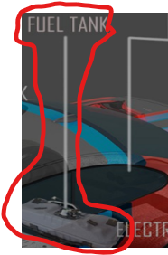
Fuel tank
A car's fuel tank is a device that stores the fuel used to power a car's internal combustion engine. It is an essential element in cars, as it ensures that fuel is always available for the engine.
The fuel tanks operate using a hermetic seal to prevent fuel leakage. Fuel is poured into the tank through the filler cap. The fuel is then pumped from the tank to the engine through the fuel system.

Slide 16

E-fuel
E-fuel, a class of synthetic fuel, are a type of drop-in replacement fuel. They are manufactured using captured carbon dioxide or carbon monoxide, together with hydrogen obtained from sustainable electricity sources such as wind, solar and nuclear power.

Slide 17

Thank you for your attention

