Slide 1


Car of the Future
Niks Brakss
Ralfs Aleksandrovics
Daniils Gornovs
RVT AV1-1
2023 Riga

Slide 2
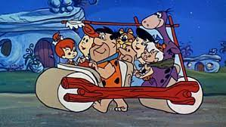
Introduction
This was our inspiration for the car, but we made some of our own adjustments

Slide 3
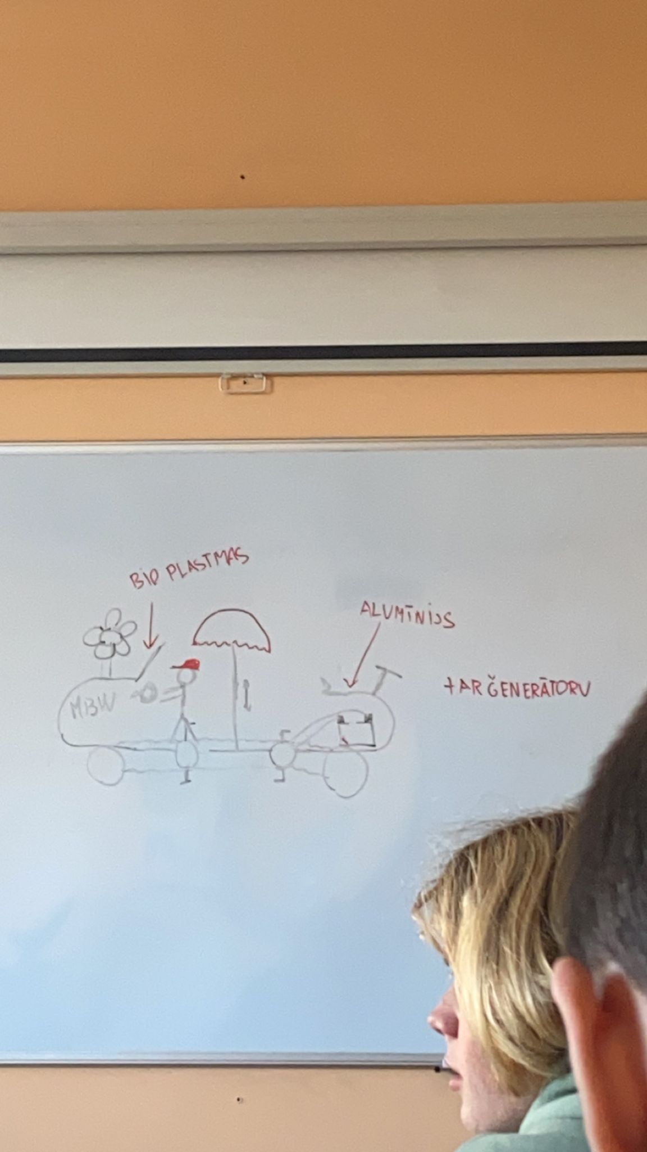
Benefits
Eco friendly
Healthy
Stylish
Electric
Zero emissions

Slide 4

How does it work???
It is powered by pedaling the pedals like a bike:
that is how it moves forward.
Pedaling also charges the battery so it can be used for the electric motor to move forward faster and without pedaling.

Slide 5
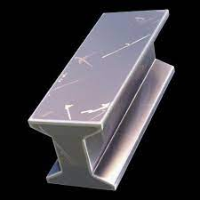
Materials
Aluminum
High grade bio plastic

Slide 6

Thank you for attention!

