Slide 1
CAR OF THE FUTURE
Jekabs Somanskis, AV-1
Sandis Švaiko, AV-1

Slide 2
THE IDEA
The idea is to take a classic car and convert it to an electric vehicle (EV)
We have chosen this idea because it is proven to be succesful and people who own classic cars are intrested in this
In real life there are already driving examples of these classic cars which have been converted to an EV

Slide 3
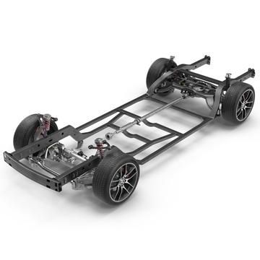
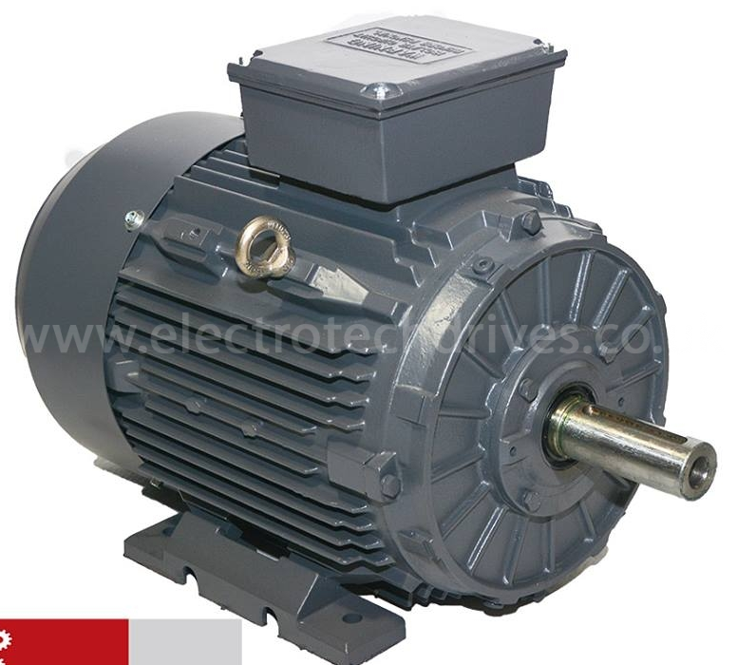
SOME COMPONENTS OF OUR ELECTRIC CLASSIC CAR
Rear suspension
Axle
Diferencial
Gearbox
Driveshaft
Front suspension
Wheels and brakes
Electric motor
Chassis

Slide 4
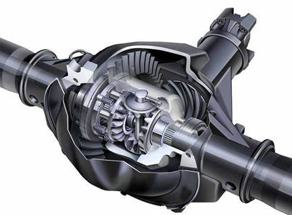
Differential
A differential is a mechanical device that allows the wheels on an axle to rotate at different speeds
This is necessary when the car is turning, as the outside wheel needs to travel farther than the inside wheel
The differential splits the power from the driveshaft and distributes it to the two wheels on an axle, allowing each wheel to rotate at the speed necessary to maintain traction and prevent the car from skidding

Slide 5
Driveshaft
The driveshaft transfers power from the transmission to the differential

Slide 6
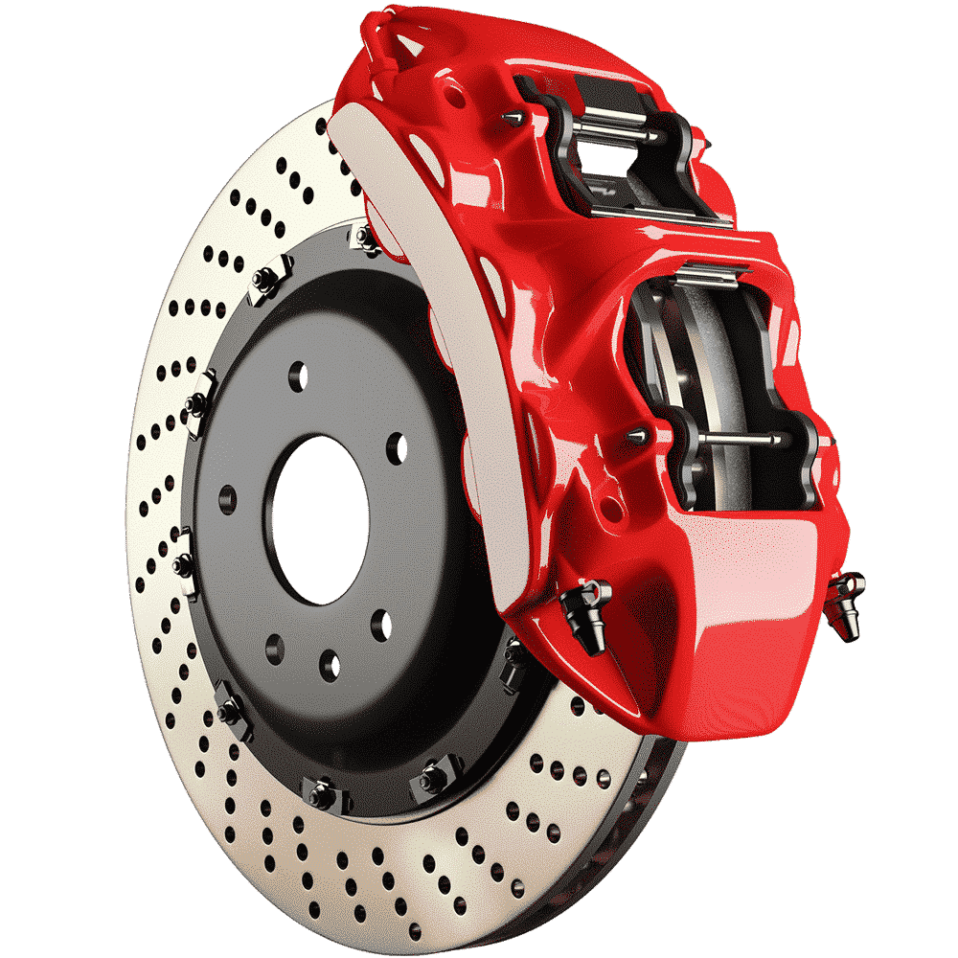
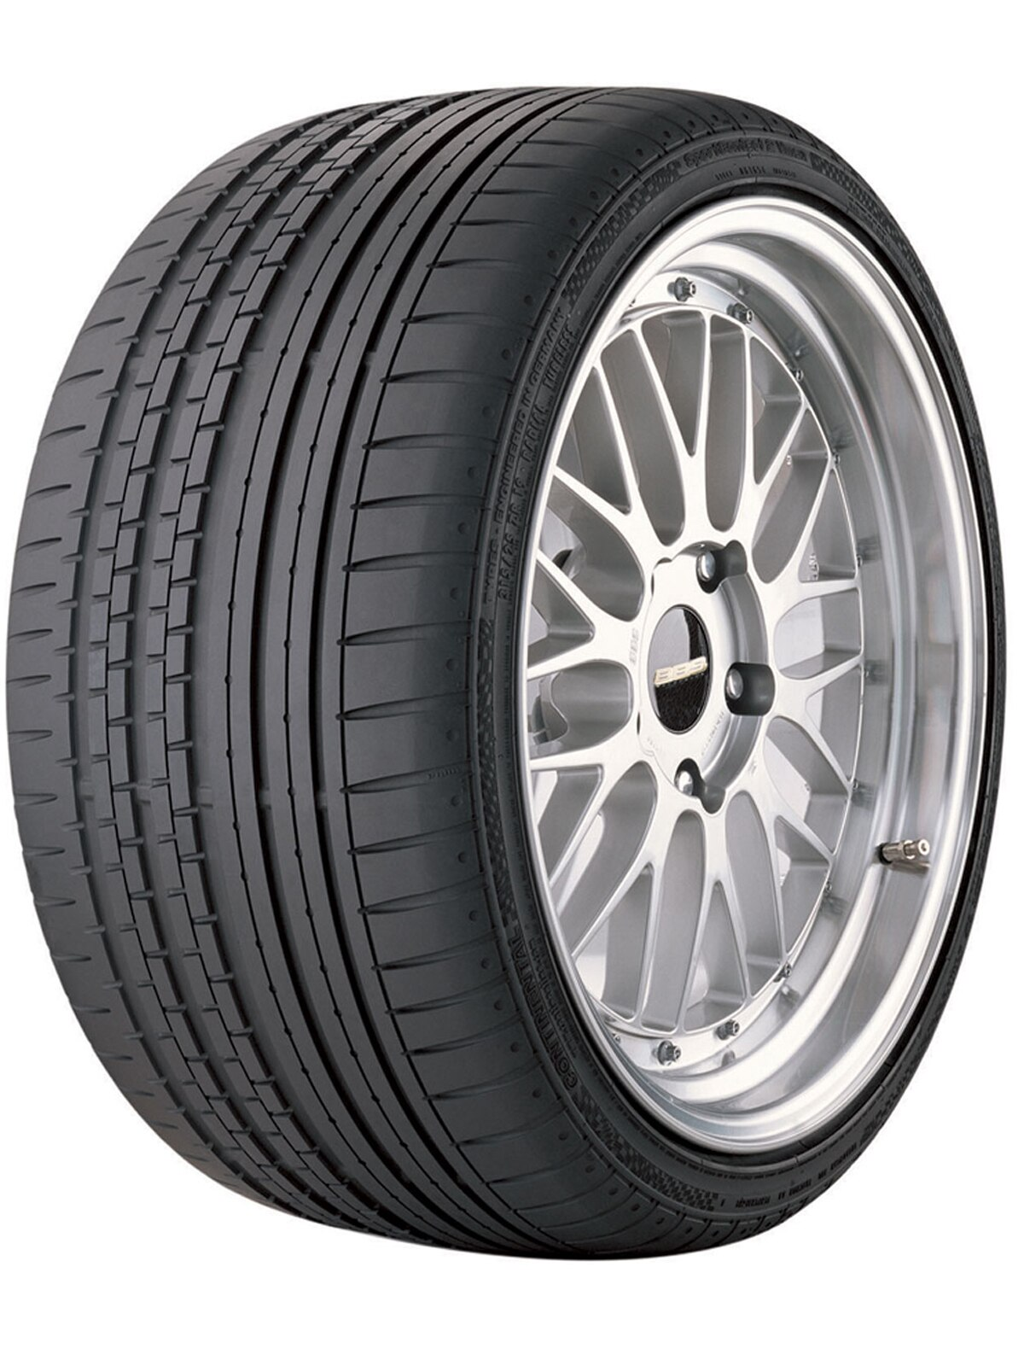
Wheels and brakes
The cars wheels and brakes are two of the most important safety components on a car
Wheels provide a platform for the tires to mount to, while brakes allow the driver to slow down or stop the car

Slide 7
Suspension
The cars suspension is a system of components that connects the wheels to the chassis and body of the vehicle
It is designed to absorb shocks and bumps from the road, provide stability and handling, and ensure a smooth ride for passengers
Front suspension
Rear suspension

Slide 8
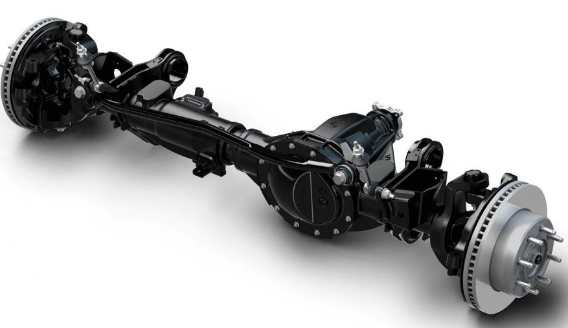
Axle
The cars axle is a shaft that connects the wheels on a car and supports the weight of the vehicle
It is a critical component of the car's drivetrain, and it is responsible for transferring power from the engine to the wheels

Slide 9
Chassis
The cars chassis is the underlying frame or structure that supports the car's body and components
It is responsible for absorbing and distributing the forces generated by the engine, wheels, and suspension during driving
The chassis also provides mounting points for the engine, transmission, axles, and other components

Slide 10
Gearbox
The gearbox is a device that changes the speed and torque of the wheels to help the car go faster, slower, or climb hills
It does this by using a set of gears with different ratios
The gearbox is located between the engine and the wheels, and it is connected to the engine by a clutch

Slide 11
Electric Motor
An electric motor is a device that converts electrical energy into mechanical energy
This means that it can use electricity to make things move
Electric motors are found in all sorts of things, from cars and appliances to toys and robots

Slide 12
THE PLACEMENT OF BATTERIES
The places where we could place the batteries of the cars could vary
For example if there is enough free space in the trunk or engine compartment, then it can be placed there

Slide 13
REAL LIFE EXAMPLES
There are some companies who offer this type of a conversion already
Our own price of the conversion would vary depending on the costumers options and vision for the car
The base price would start from 10,000 euros
This an old Jaguar which has been converted to EV

Slide 14
BENEFITS OF OWNING AN EV IN LATVIA
The main benefit of owning an electric car in Latvia is that you do not have to pay the car road tax
You can drive on bus lanes
Zero emissions
Free parking in big cities like Riga and Liepaja
Electric cars are really quiet

Slide 15
THANK YOU FOR YOUR ATTENTION!

