Slide 1
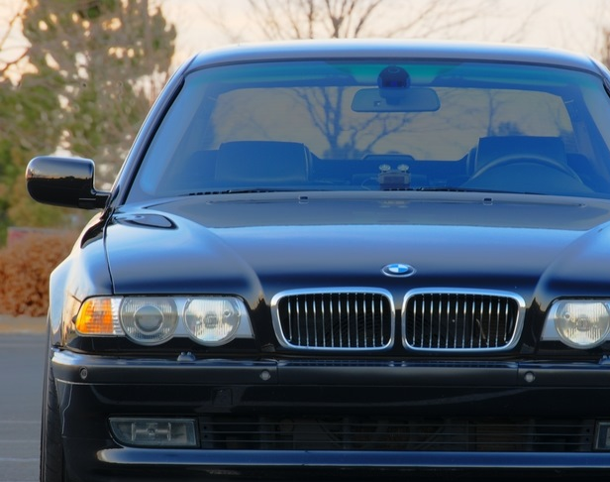
BT38 Vladislavs Jegorovs Ričards Jaševs Viljams Bezprozvanovs AV1-1

Slide 2
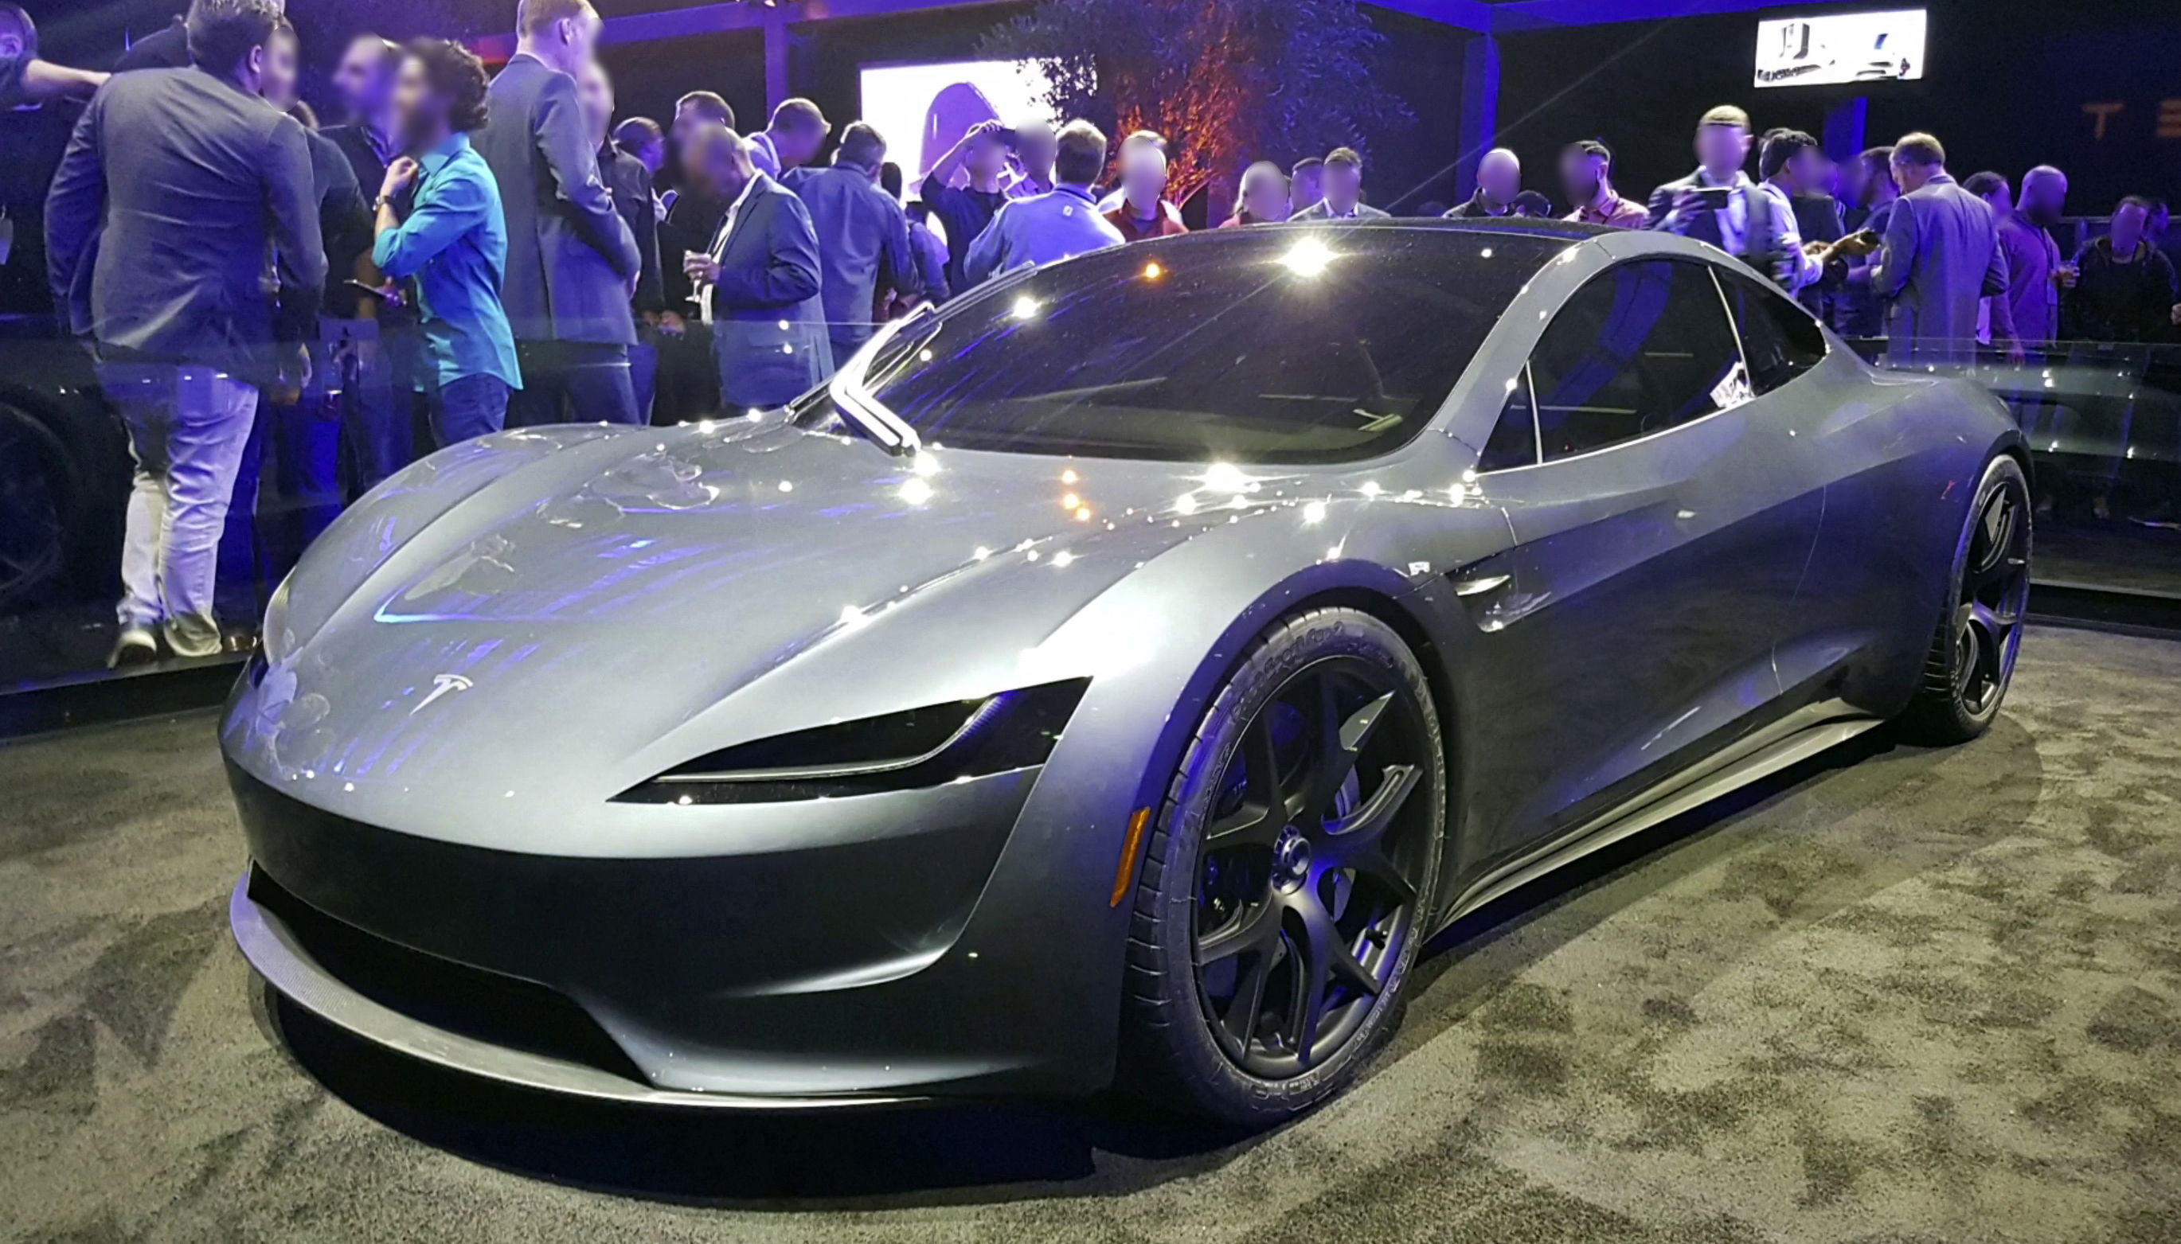
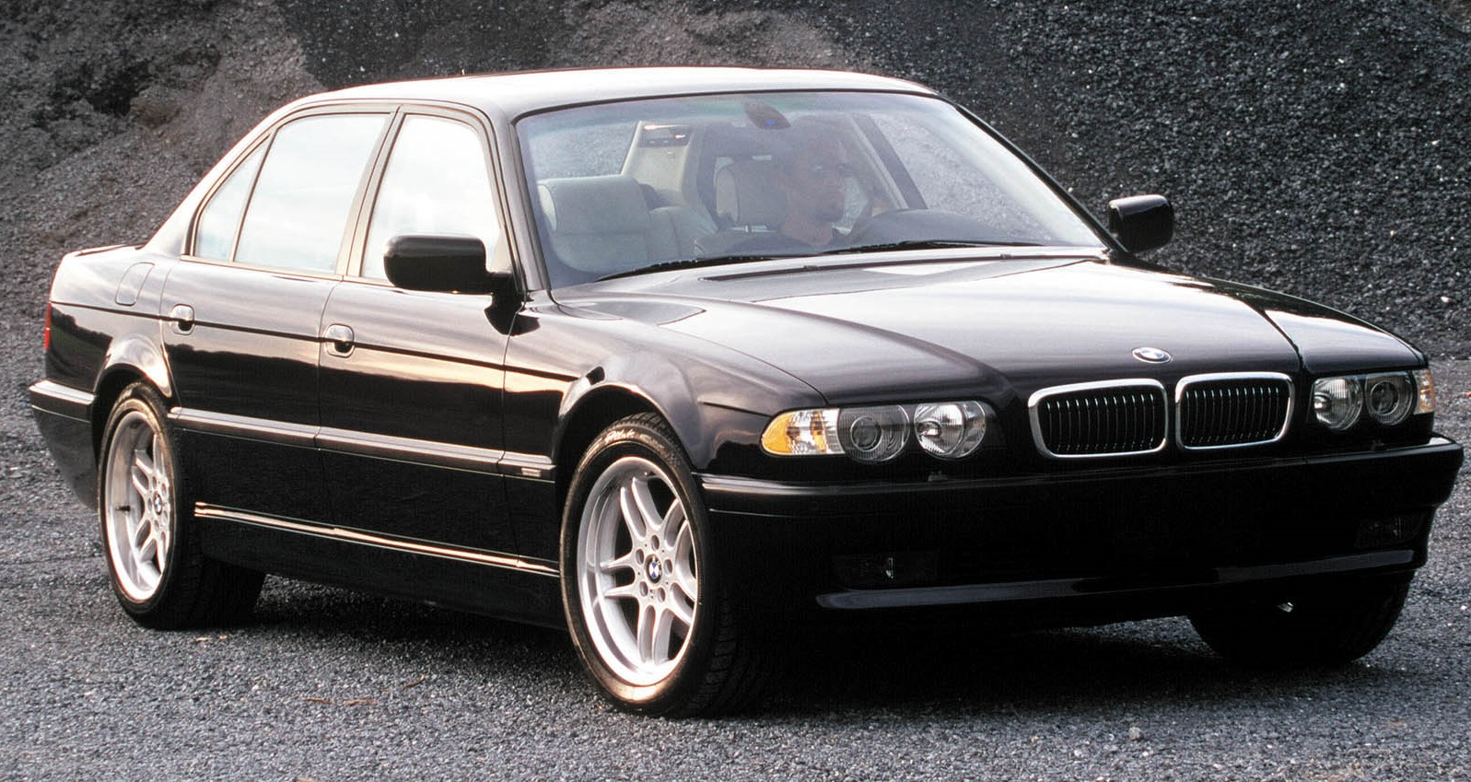
BT38
BT38 is two cars under this name
The exterior is from the BMW
Interior is from the Tesla as well as the engine and drivetrain

Slide 3
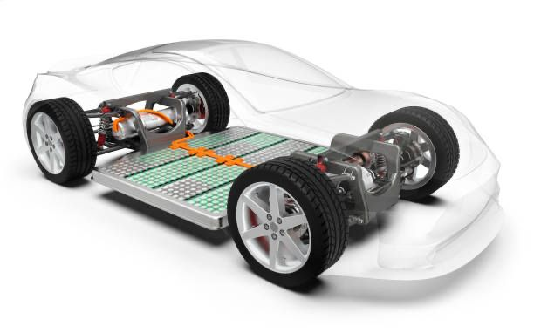
BT38
BT38 is an exceptionally eco-friendly vehicle thanks to its electric powertrain sourced from the Tesla Roadster
This innovative car not only reduces the carbon footprint
Also it offers a luxurious and stylish driving experience with its BMW E38 exterior

Slide 4
The technical specifications of the BT38 are impressive
The all-wheel-drive Roadster will be equipped with three electric motors (one in the front and two in the rear)
This car accelerates from 0 to 97 km/h in just 1.9 seconds and up to 160 km/h in 4.2 seconds, with a maximum speed of 400 km/h

Slide 5
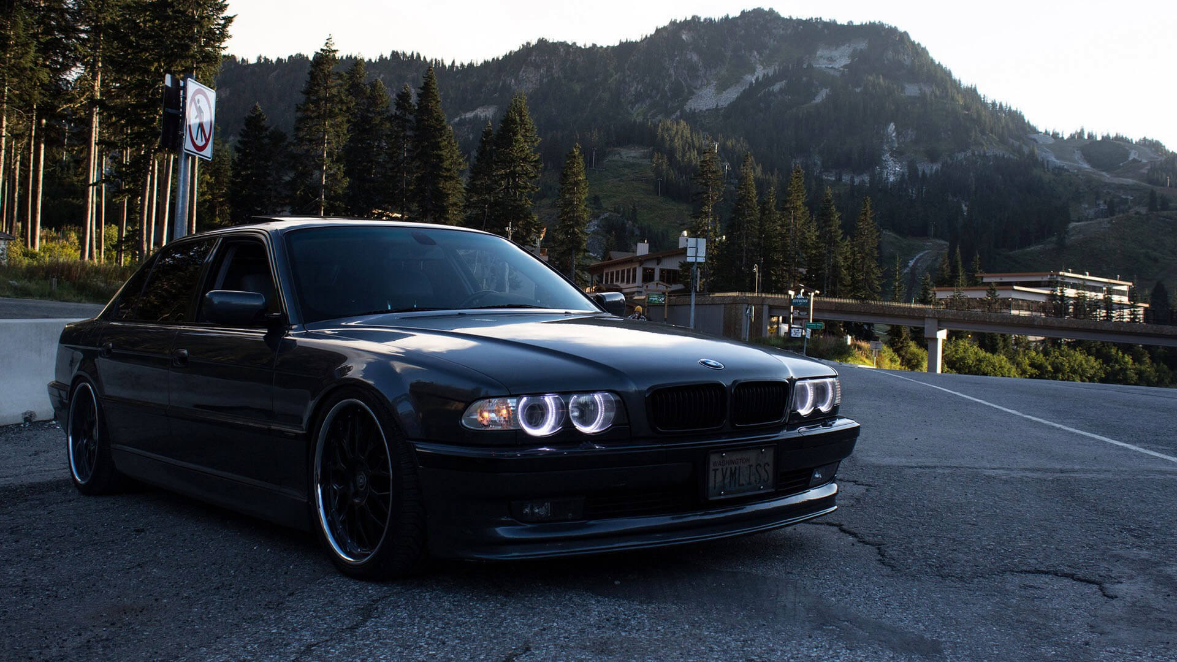
THANK YOU FOR YOUR ATTENTION

