Slide 1
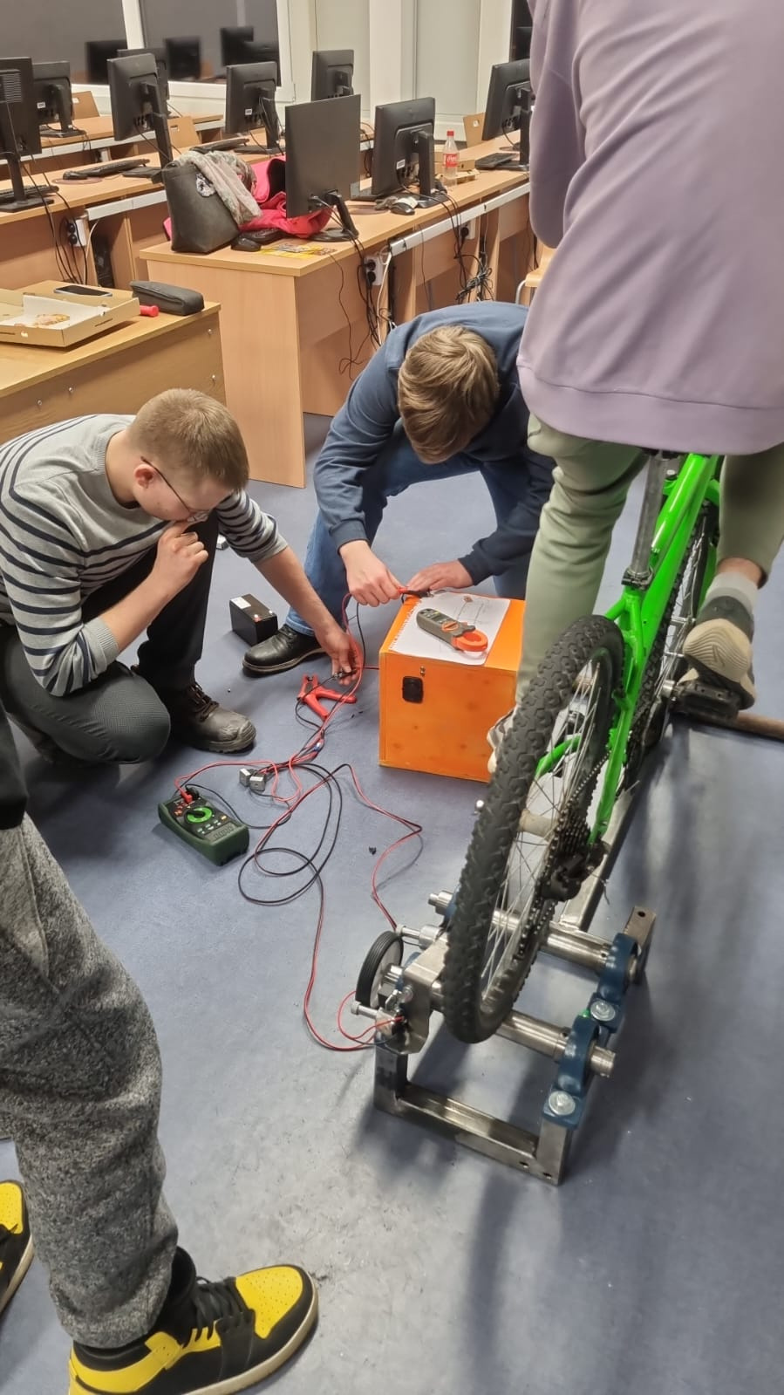

Powering the Future: Bicycle as a Generator

Slide 2
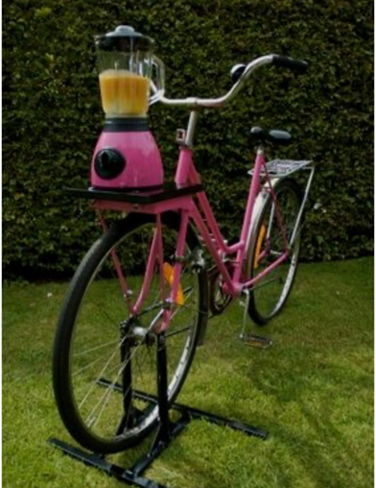
Introduction to the project
In this project, vocational students will use a bicycle to generate electricity. Pedaling for power is a sustainable and fun way to learn about energy production.
inspiration

Slide 3
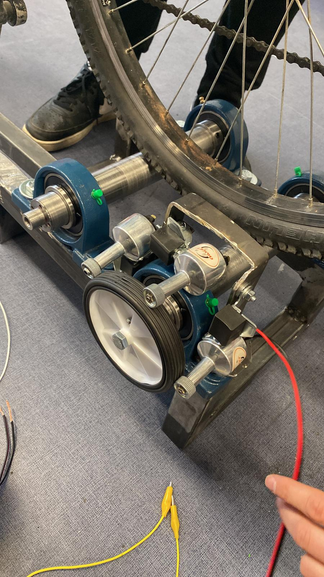
Objective of the project
The objective of this project is to create a bicycle-powered generator that can produce electricity through pedaling. The project will not only promote physical activity but also contribute to sustainable energy production.

Slide 4
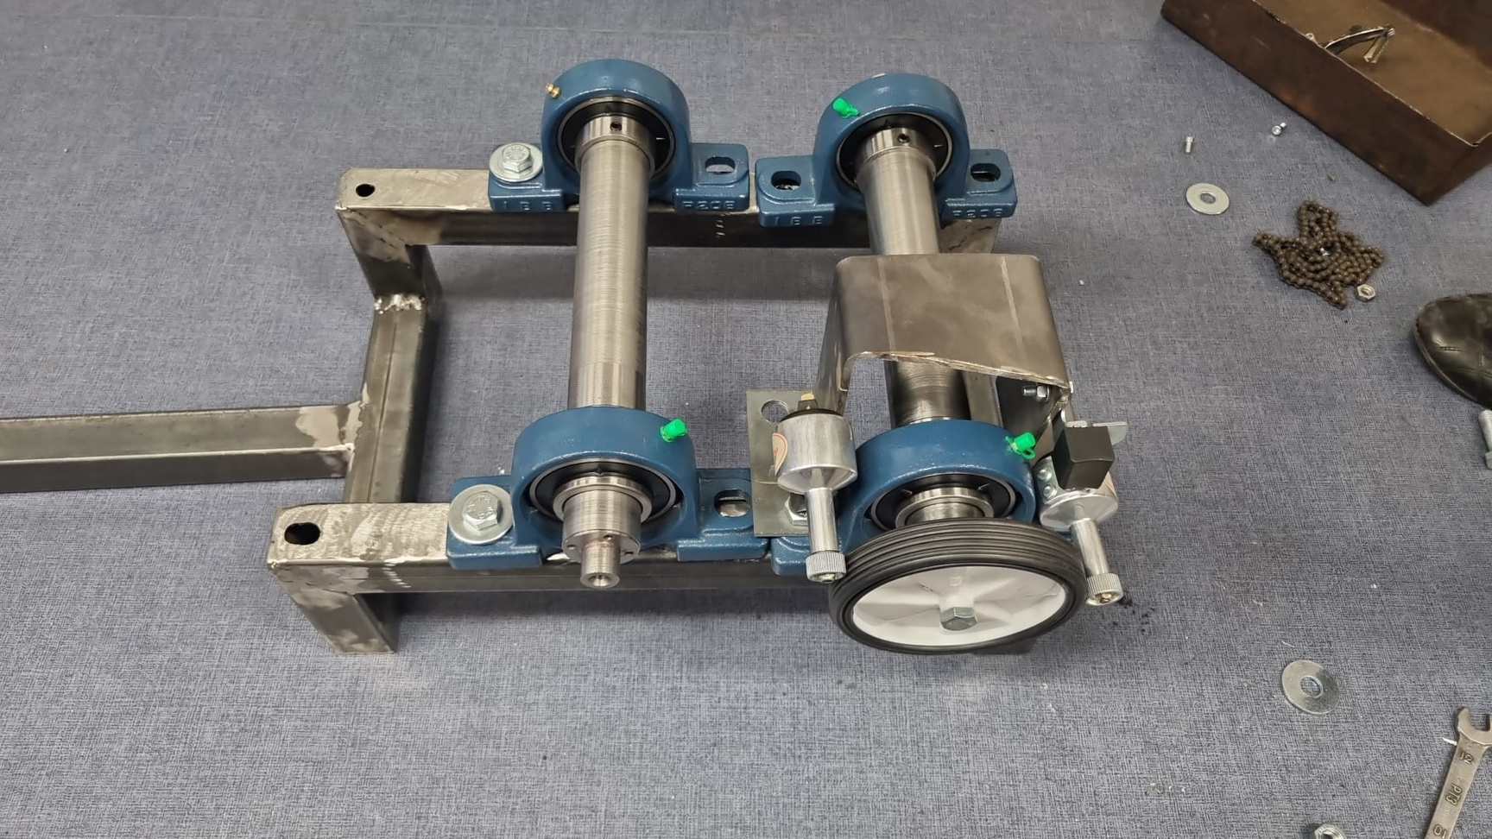
Applications of Bicycle Generator
Generate electricity while exercising.
Charge small electronic devices like phones and tablets.
Power small appliances like lights or fans in off-grid settings.

Slide 5
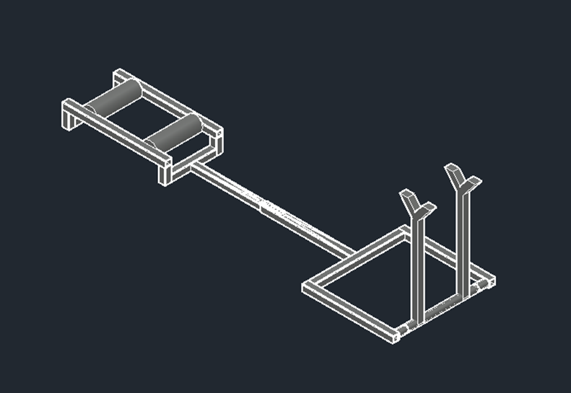
First idea
The first project that provided for the bicycle to be attached behind the steering wheel.

Slide 6
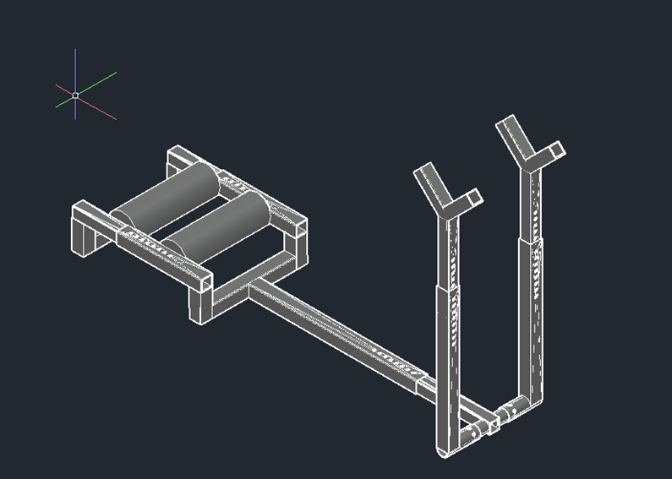
Second idea
the bike will moun with the front wheel.
At the last stage of assembly, one of the rolls needs to be made into a lead for a current generator, with the help of which it will be possible to charge electrical devices. The drive from the roll to the generator will be made with the help of two wheel gears and a chain.

Slide 7
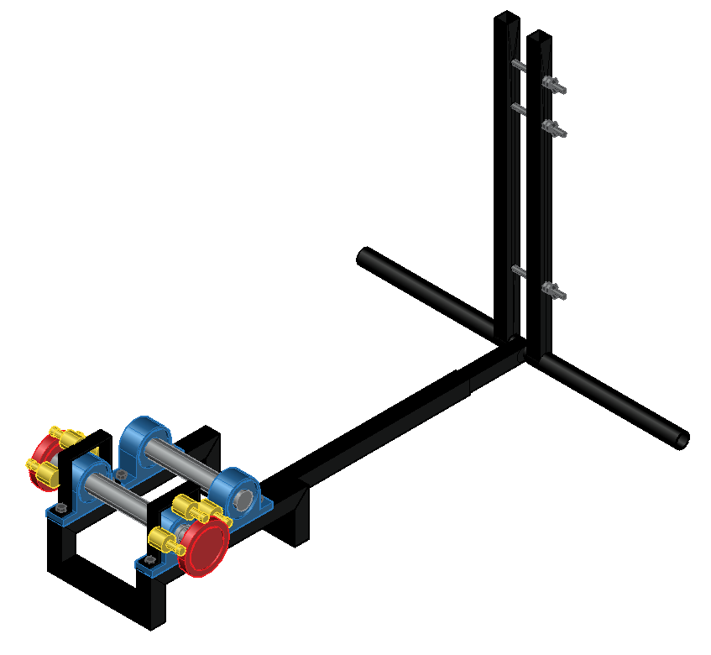
Last idea
Dynamo.

Slide 8
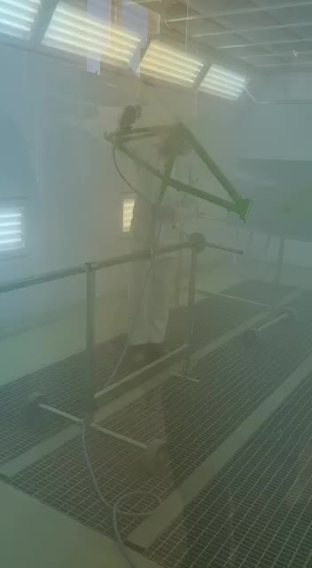
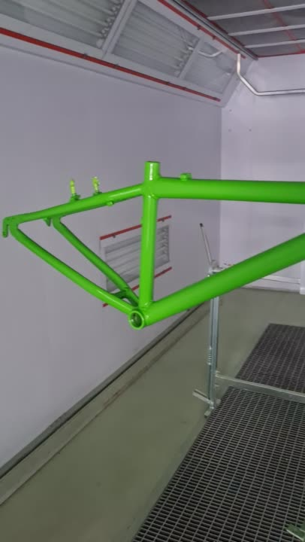
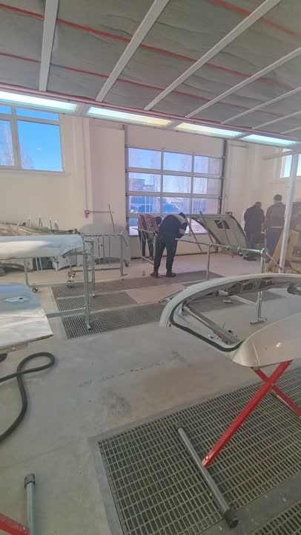

Slide 9
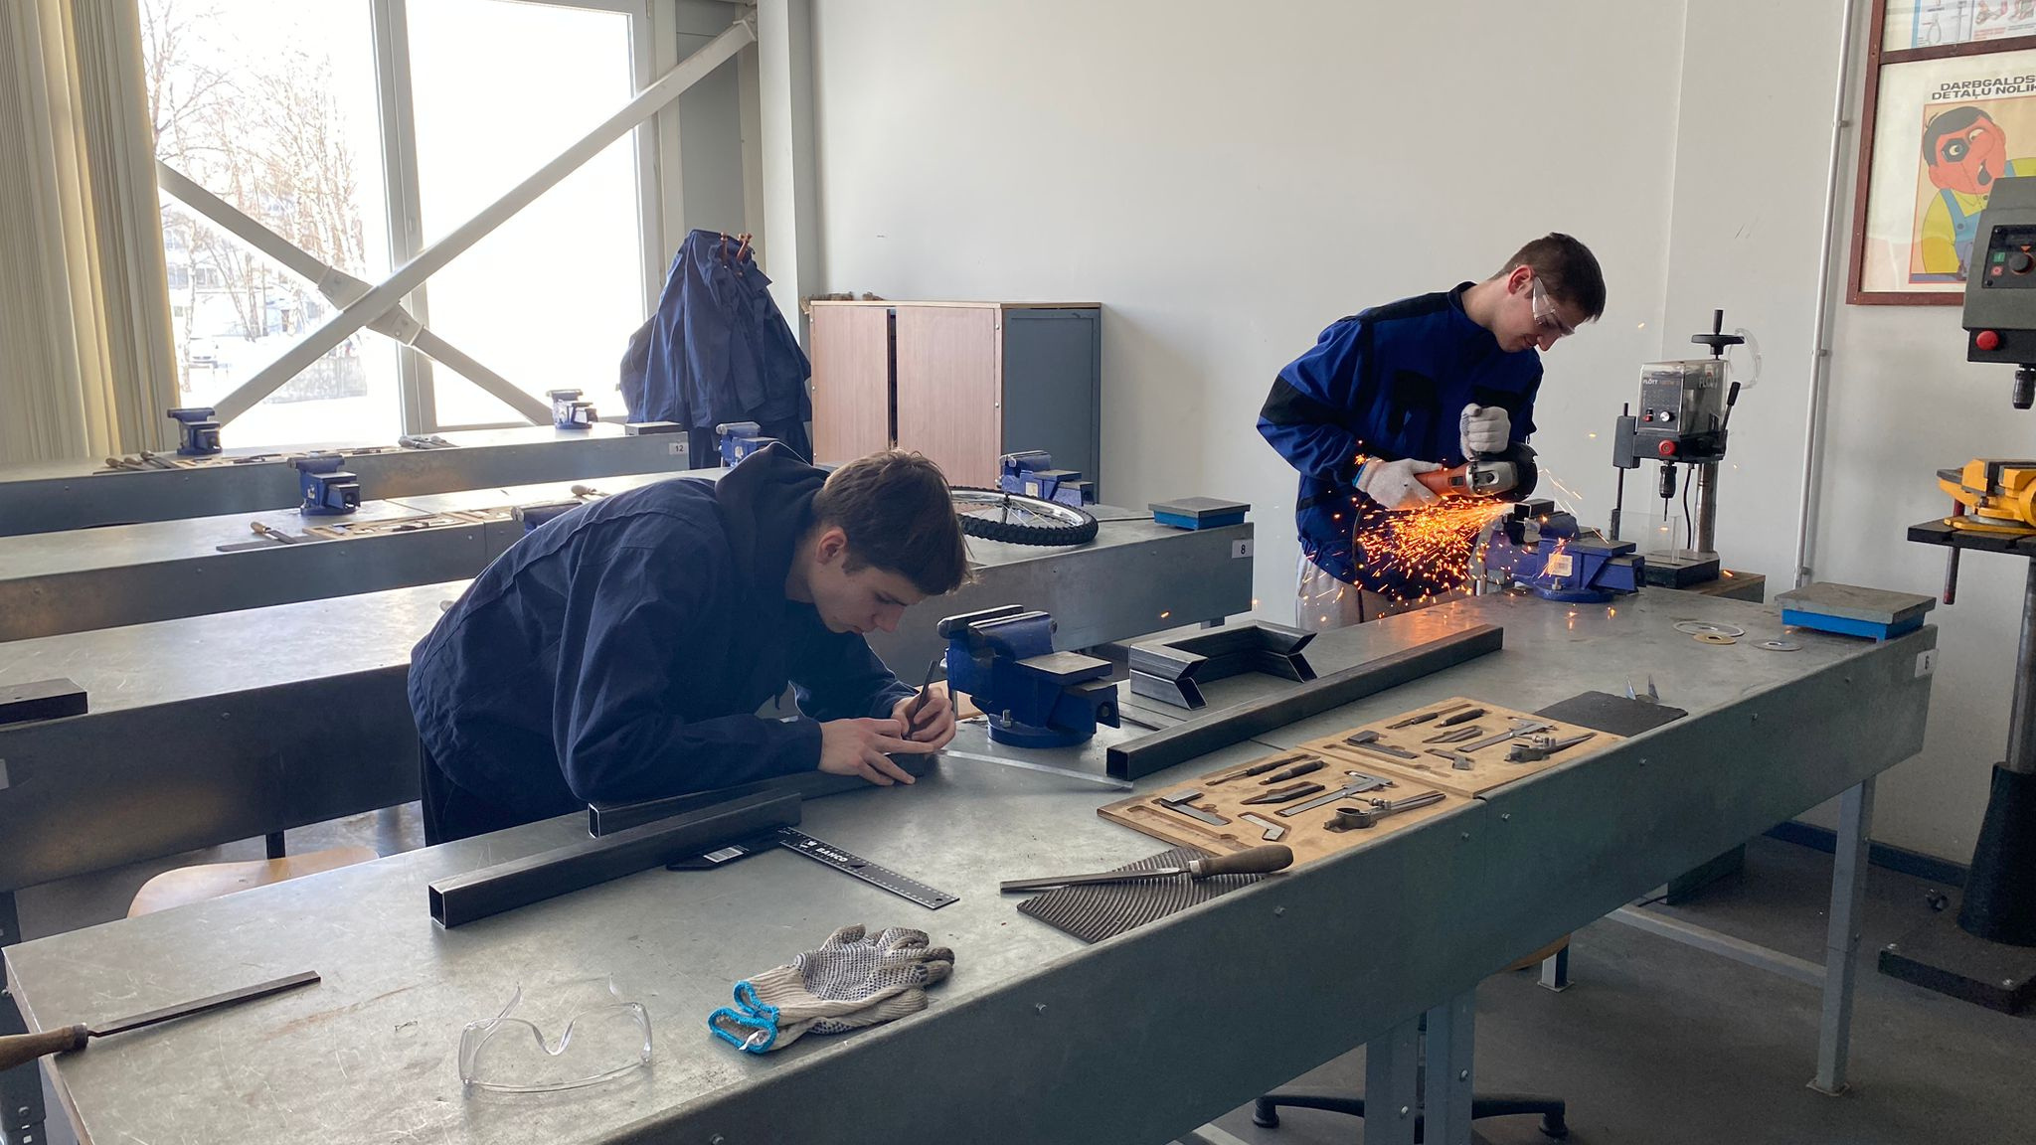

Slide 10
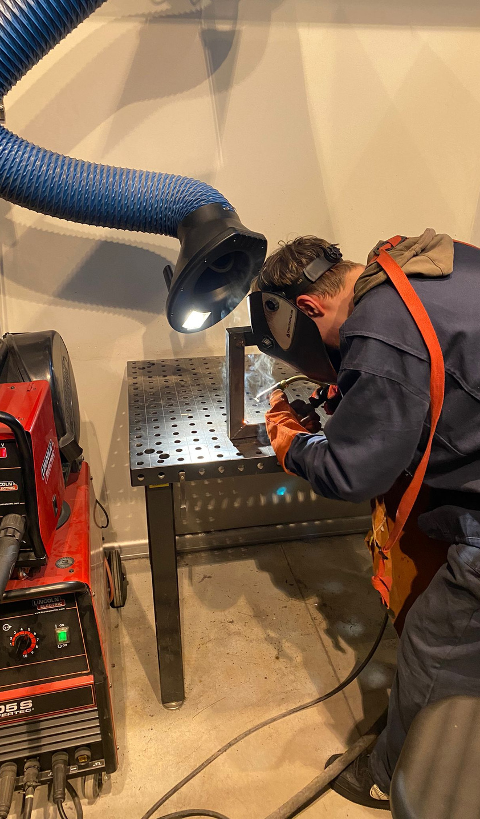
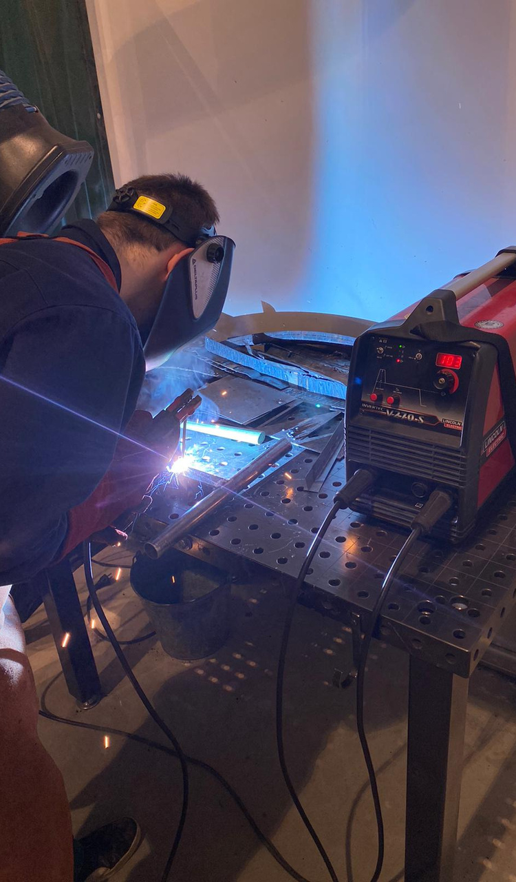
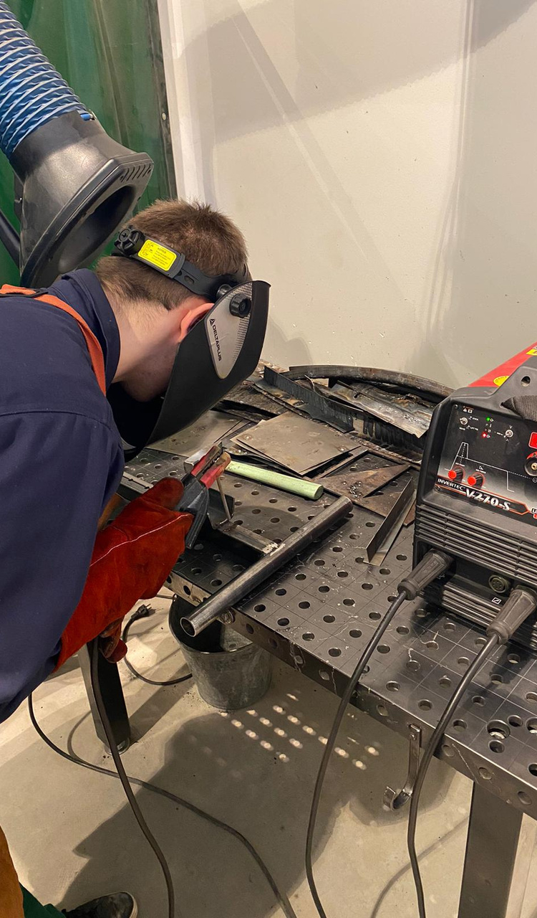

Slide 11
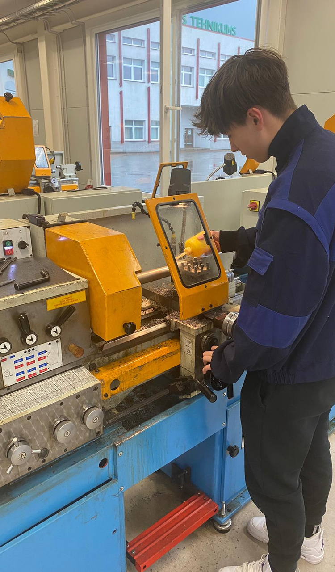
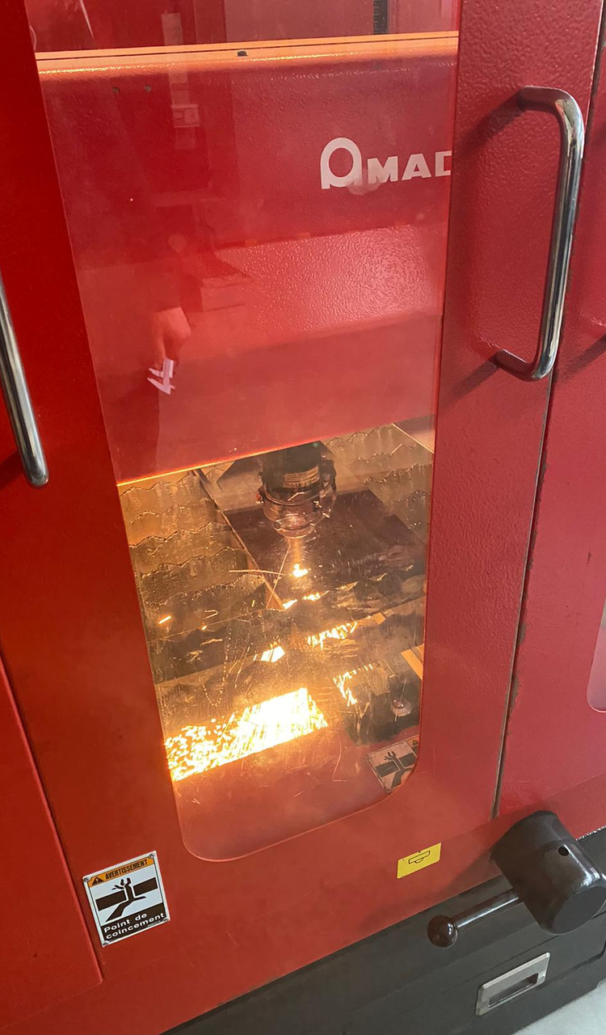
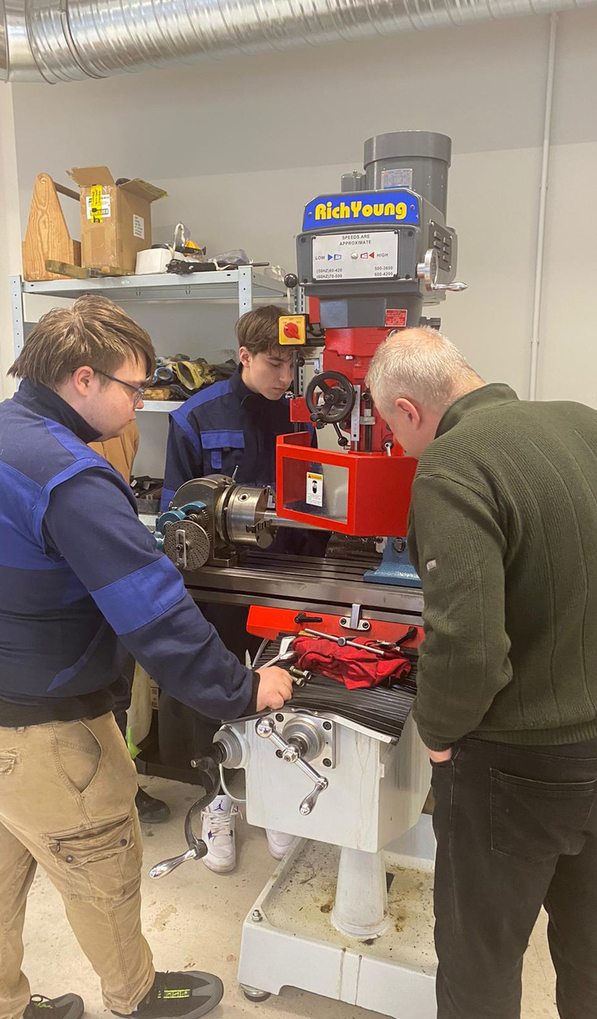

Slide 12
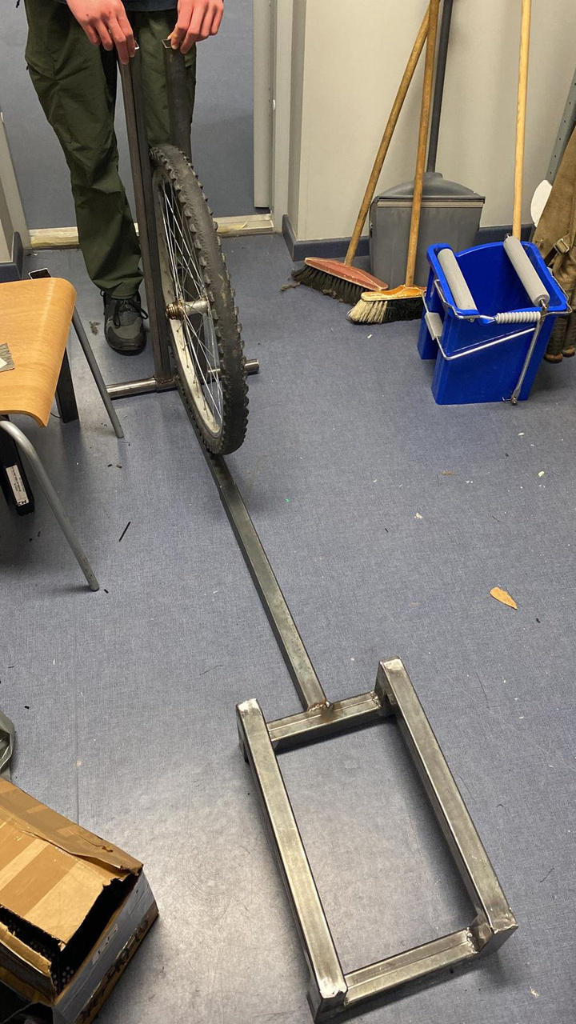
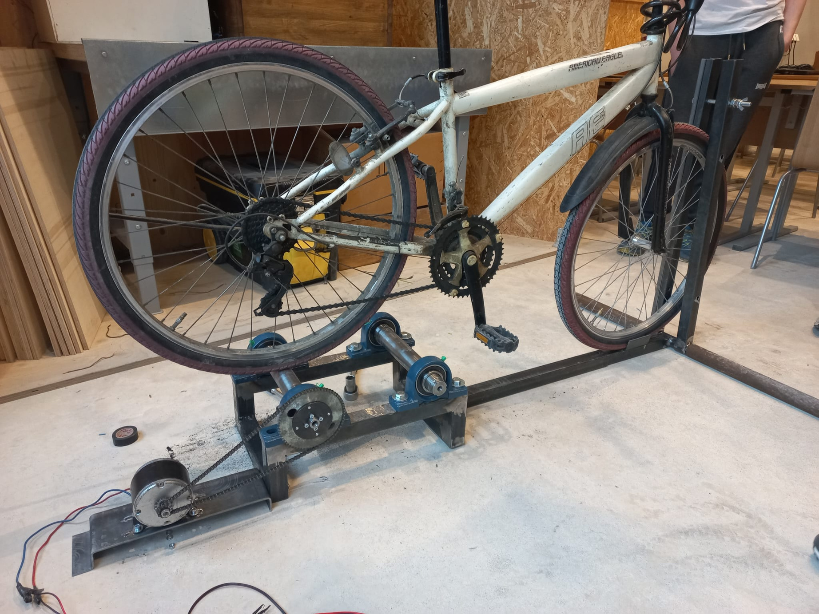

Slide 13
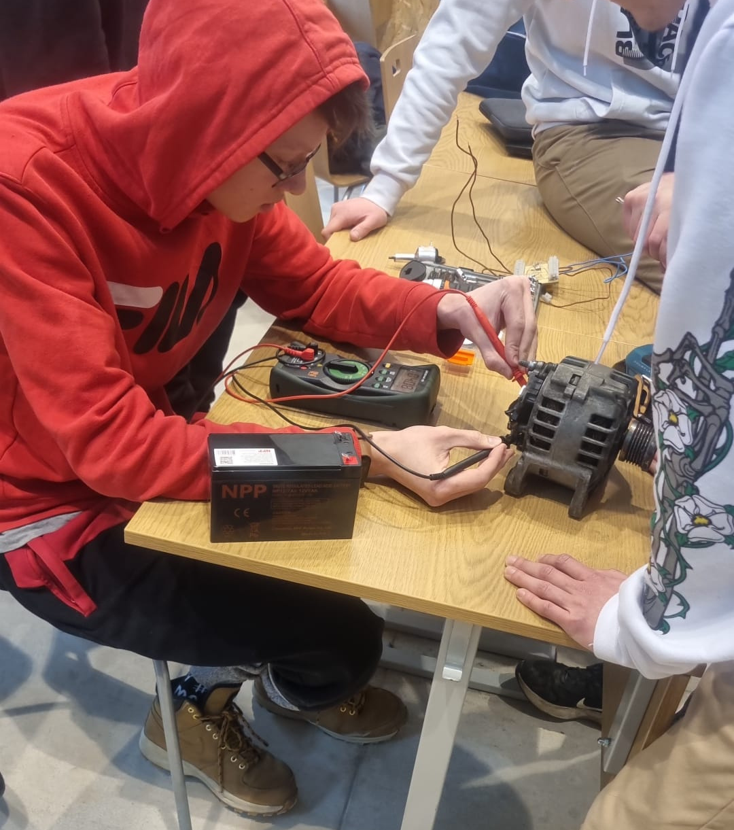

Slide 14
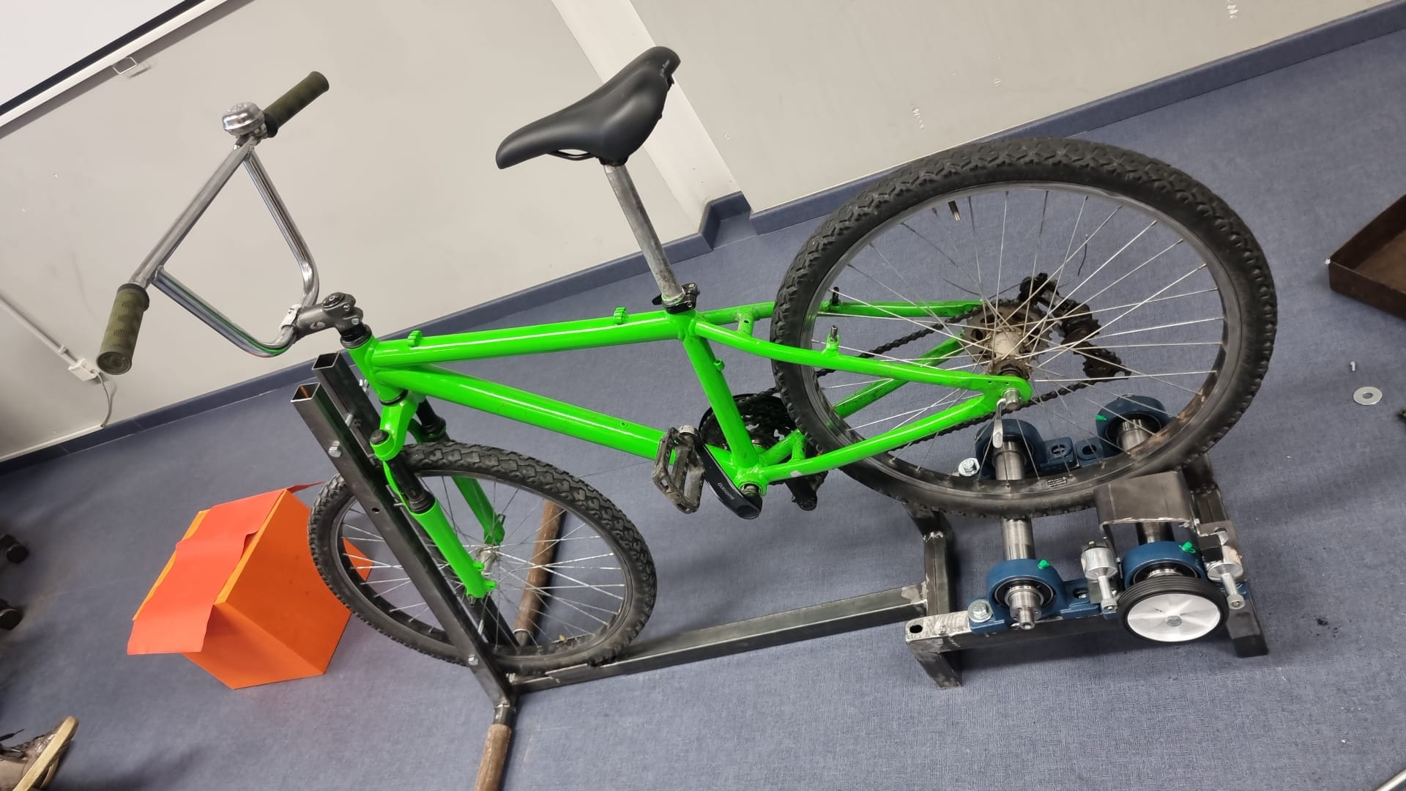

Slide 15
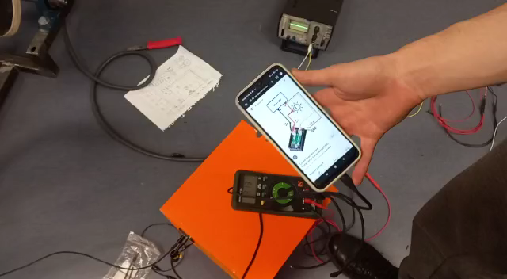

Slide 16
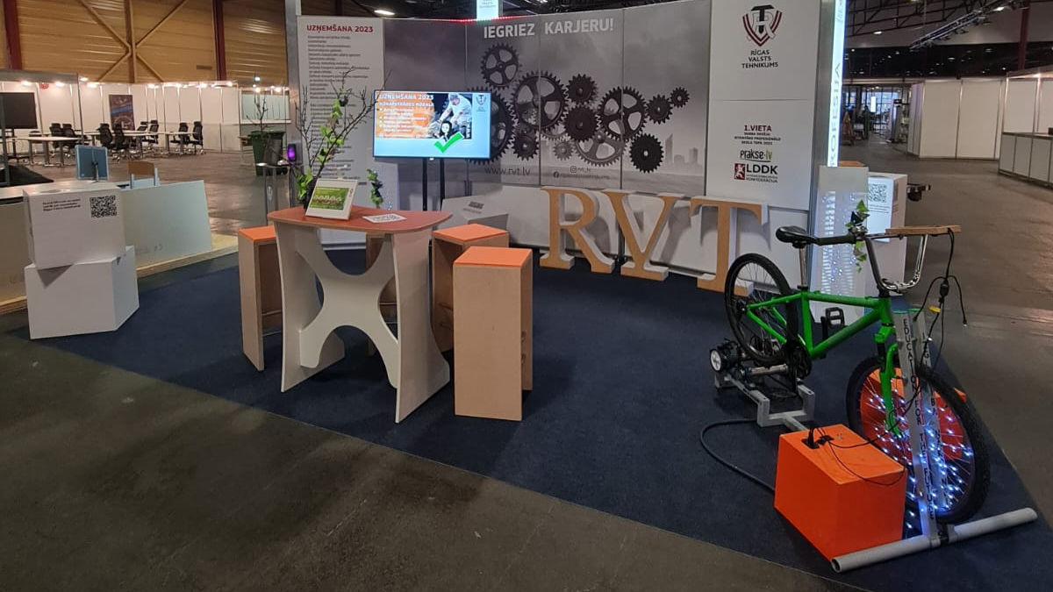

Slide 17
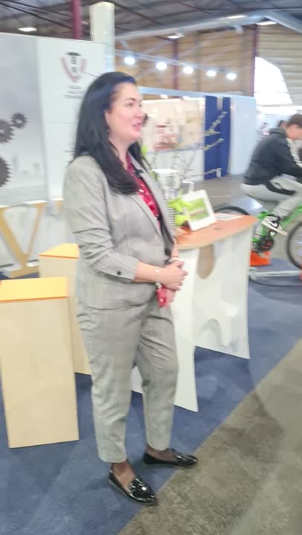
Conclusion and Future Scope
The bicycle generator project is a perfect example of using sustainable energy to power our daily lives. Future scope includes implementing similar projects in other schools and communities, workplaces to promote clean energy and reduce carbon footprint.

Slide 18
Thank you for giving us the opportunity to share our project with you!

